Slide 1
Basic Health & Safety
Fire Safety Induction 2025
Tactical Security Options Ltd,
Room 704 Cameron House White Cross Industrial Estate
South Road Lancaster LA1 4XF
Tel: 07787788811
dgap@Hotmail.co.uk
Dave Pattinson 28.19 V4 2025

Slide 2
Health & Safety - Fire Safety Advisors for today are:
Dave Pattinson, Stacey Vivian
dgap@Hotmail.co.uk
Tel: 077877888111
Please……….
  Make sure you have signed the register
  Turn off mobile phones, pagers etc.

Slide 3
Why is it important?
Legal obligation Health & Safety Act 1974
Public expectation
Professional standards PSIA & SIA Guidance
The needs of our clients will drive everything we do
Notes:
Legal obligation under the Regulatory Reform (Fire Safety) Order 2005 to manage fire safety and provide safe environment for employees and non employees. Also H&SW Act 1974 to provide a safe work place.
Public Expectation – The public, patients, visitors etc. will expect to be safe in a hospital environment.
Professional standards – Individual pride in work, competence etc.
The needs of our patients underpins all our activities – safety must be paramount and we need to be able to demonstrate organisational competency in action to be taken in the event of fire.

Slide 4
This Session
Introduction
Aim and Outcomes
General Fire Precautions
Action in the event of fire
New Developments
Health & Safety
Open Forum
Notes:
Identifies framework of session; key issue is to encourage open discussion, questions and challenge.

Slide 5
Aim
To ensure all staff are aware of the action to be taken in case of fire.
Notes:
Clear aim that the session is all about ensuring staff are aware of actions to be taken and that the Trust can demonstrate training has been given.

Slide 6
Outcomes
Understand the components of a fire
Appreciate the main causes of a fire
Understand the basic legal requirements and evacuation procedure
To become competent with the management of fire safety
Identify types of extinguishers and their use.
Notes:
Understand the components of fire – Basic triangle of combustion and how fire is extinguished.
Appreciate the main causes of fire – Outline of main causes of fire in NHS premises.
Understand the basic legal requirements and evacuation procedure – Staff need to be aware of individual responsibilities and how these are applied in the workplace.
To become competent with the management of fire safety – Although aimed primarily at managers; everyone has a part to play in ensuring a safe environment for our patients, visitors and work colleagues.
Identify types of extinguishers and their use – Two types of extinguisher and basic instruction on usage. Brief mention of fire blanket and the effectiveness of this simple method of firefighting.

Slide 7
The Anatomy of Fire
FIRE
OXYGEN
HEAT
FUEL
Notes:
Opening discussion about the triangle of combustion. Describe what is required for fire to occur and how any one of the sides will result in extinction.

Slide 8
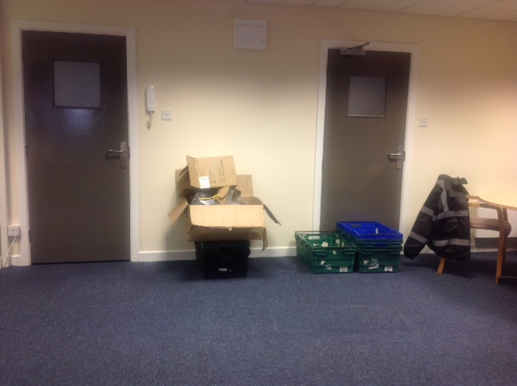
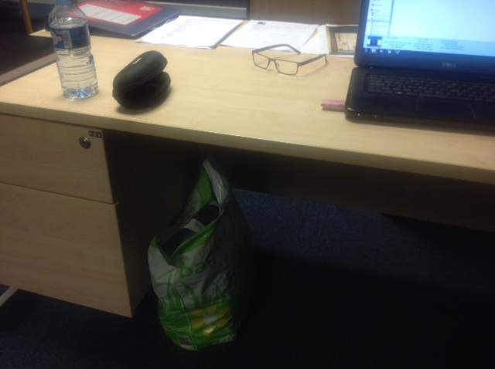
From this ………..
Notes:
Shock style introduction – Apologise if the untidy office embarrasses anybody, but this is the situation that leads to rapid fire spread due to poor housekeeping and combustible fire loading. Describe how triangle of combustion forms.

Slide 9
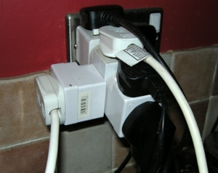
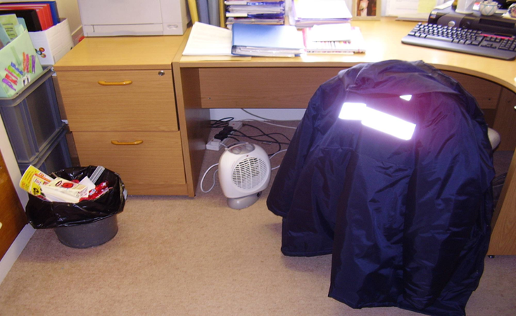
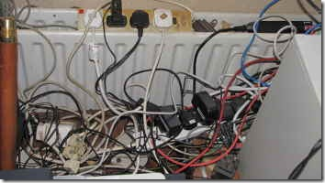
or this ………..
Notes:
Slide showing hazards of portable heater supplied by multi-point adaptor. Looks like fire is being used to dry clothing

Slide 10
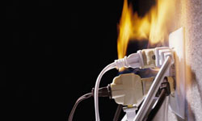
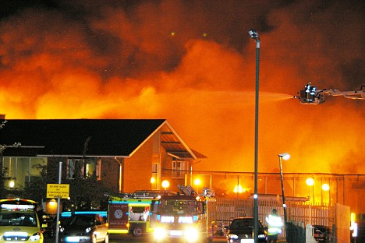
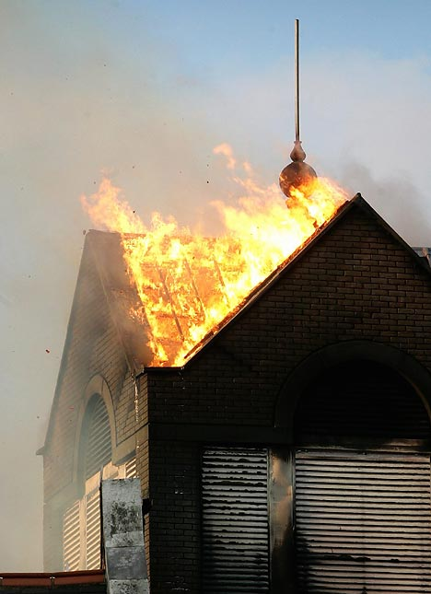
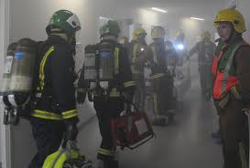
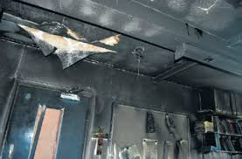
To this ………..
Notes:
Severe fire situation.

Slide 11
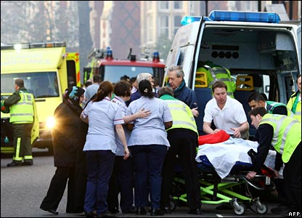
and this ………..
Notes:
Evacuation of patients.

Slide 12
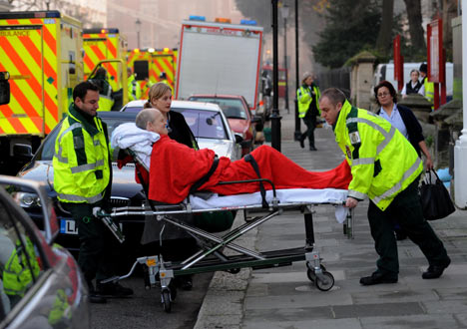
and this ………..
Notes:
Evacuation of patients.

Slide 13
Causes of Fire in Office Premises
Cooking equipment
Careless smoking by visitors and staff
Equipment failure, electrical
Arson
Poor House keeping.
Notes:
Generalised list of causes.

Slide 14
Common Denominator
PEOPLE
Most fires at work are caused by:-
Poor judgement
Human error
Failure to follow instructions.
Notes:
The people factor is a root caused of all fires.

Slide 15
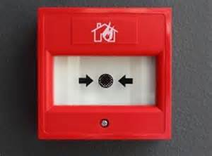
Fire Alarm Activation
Manual - Breaking the glass of any fire alarm point MCP (Dial 999)
Automatic - Smoke or Heat Detectors
Activation of the fire alarm system will
set off the fire alarm indicator panels.
if there is a fire the server may go down taking the telephone lines out, staff MUST call (999) every time.
Notes:
Types of fire alarm activation.

Slide 16

Fire Alarm Activation
Notes:
Types of fire alarm activation.

Slide 17
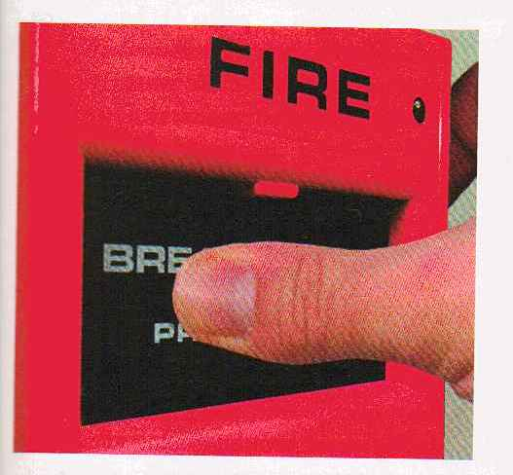
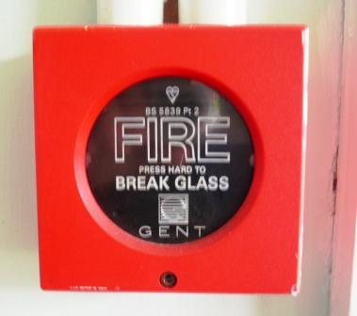
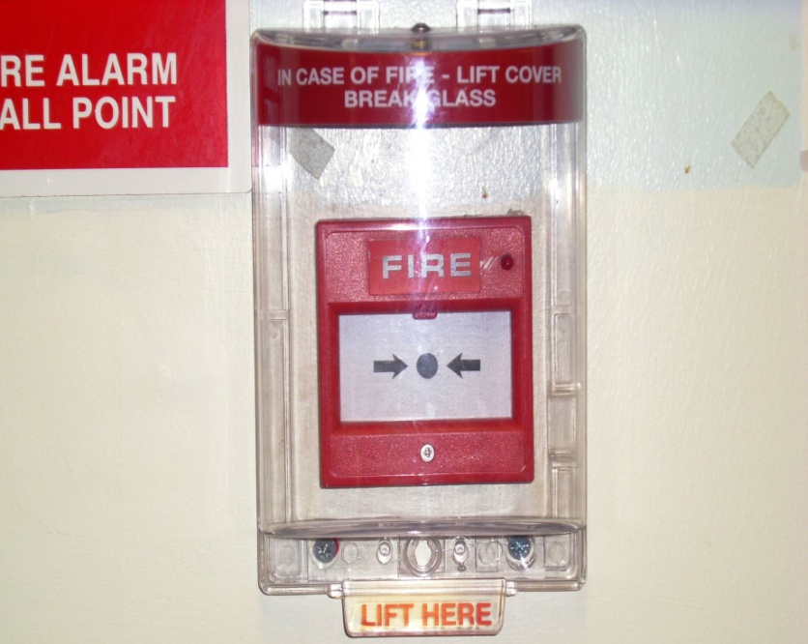
Manual Fire Alarm MCPs
Standard type
All Red in Colour
Protected
Notes:
Different call points.

Slide 18
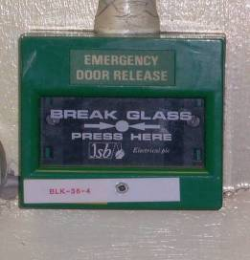
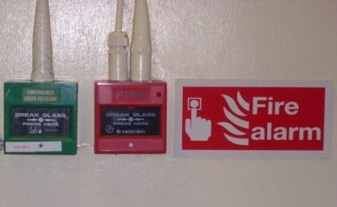
Do Not Confuse ……
Emergency Door
Release
Sometimes sited together
Notes:
Can be confused with emergency door releases. Care should be taken to know which is which.

Slide 19
Fire Evacuation Plan
A continuous alarm sound will indicate that there is a fire in your part of the office block.
(Weekly test) will be carried out on a Friday.
(Fire Drills) we will carry out every six months or wherever there is a change.
Notes:
Continuous alarm – Evacuate immediately (non patient area). Investigate/await instruction in patient area.
Intermittent Alarm – On hearing an intermittent alarm sound staff should remain at their place of duty from where they may be summoned if required.
BE PREPARED – to evacuate should the alarm change to a continuous sound.

Slide 20


Fire Action
  Close doors & Windows
  Await instruction
Intermittent
Intermittent
Intermittent
Continuous Alarm
  Non patient area
  Leave building by nearest exit
  Report to Assembly Point
Intermittent
Intermittent
  Patient area:
  Staff await Instructions
  Manager Investigate
Notes:
Pictorial description of how the fire alarm system works and action to be taken at each stage.

Slide 21
Evacuation, Assembly and Role Call
The senior person shall be responsible for:-
Co-ordination of the evacuation
Carrying out a sweep and search of all rooms where possible and safe to do so
Positioning fire wardens to prevent entry to area
Ensuring a role call is taken.

Slide 22
Evacuation, Assembly and Role Call

Slide 23
Evacuation, Assembly and Role Call
Evacuate ground floor office and building
Exit main blue door in to car park or fire exit to the left of the office
Roll call at assembly point by car park
Call 999 await fire service for brief

Slide 24

Progressive Horizontal Evacuation
_{Fire}
_{Stairs}
_{Fire}
_{Stairs}
Bay 1
Bay 2
Bay 3
Bay 2
Nurses
Station
Ward 3
Doctor
Bay 6
Clinic
Pantry
Bay 5
Ward 2
Courtyard
Courtyard
Courtyard
Ward 4
_{ASSEMBLY}
_{POINT}
Notes:
The terminology associated with Hospital Horizontal Evacuation and Refuges (Assembly Points) covers:
Evacuation - the rapid and orderly removal of patients, visitors and staff in priority order from danger as instructed by the Fire Team Leader BRONZE.
Horizontal - remaining on the same level of the building until advised that patients etc will have to be moved to a lower level or to another building. Patients are to remain in the building until clear instructions are given for their removal elsewhere as many patients would be adversely affected by the weather even in summer.
Assembly point - any space or room large enough to cope with an influx of about 30 patients and their medical equipment vital for survival designated as a refuge. Assembly points must be near to lifts or stairs that are suitable for vertical evacuation should it become necessary. Rooms are used for other functions until evacuation is ordered.
Refuge - NHS term for assembly point

Slide 25
Securing of Building
Upon receiving orders to re-enter the office block by a Senior Fire Officer, carry out the following:
Check and secure all fire doors
Check and ensure fire equipment is operational and reported if used
Log the event on an incident report
Notes:
The terminology associated with Hospital Horizontal Evacuation and Refuges (Assembly Points) covers:
Evacuation - the rapid and orderly removal of patients, visitors and staff in priority order from danger as instructed by the Fire Team Leader BRONZE.
Horizontal - remaining on the same level of the building until advised that patients etc will have to be moved to a lower level or to another building. Patients are to remain in the building until clear instructions are given for their removal elsewhere as many patients would be adversely affected by the weather even in summer.
Assembly point - any space or room large enough to cope with an influx of about 30 patients and their medical equipment vital for survival designated as a refuge. Assembly points must be near to lifts or stairs that are suitable for vertical evacuation should it become necessary. Rooms are used for other functions until evacuation is ordered.
Refuge - NHS term for assembly point

Slide 26
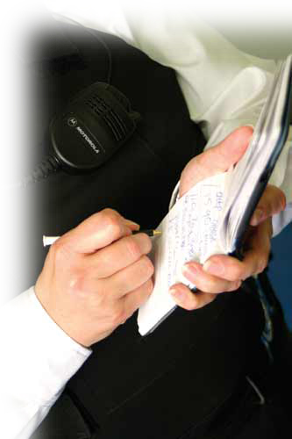
Reporting & Accountability
Log the event on an incident report
Report findings to a Senior Manager
Inform work colleagues
Notes:
The terminology associated with Hospital Horizontal Evacuation and Refuges (Assembly Points) covers:
Evacuation - the rapid and orderly removal of patients, visitors and staff in priority order from danger as instructed by the Fire Team Leader BRONZE.
Horizontal - remaining on the same level of the building until advised that patients etc will have to be moved to a lower level or to another building. Patients are to remain in the building until clear instructions are given for their removal elsewhere as many patients would be adversely affected by the weather even in summer.
Assembly point - any space or room large enough to cope with an influx of about 30 patients and their medical equipment vital for survival designated as a refuge. Assembly points must be near to lifts or stairs that are suitable for vertical evacuation should it become necessary. Rooms are used for other functions until evacuation is ordered.
Refuge - NHS term for assembly point

Slide 27
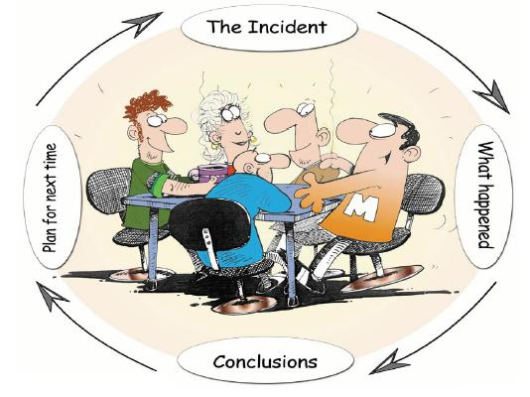
Meeting
Have a meeting de-briefing regarding the fire evacuation
Learn from it or adjust the RAMs accordingly
Notes:
The terminology associated with Hospital Horizontal Evacuation and Refuges (Assembly Points) covers:
Evacuation - the rapid and orderly removal of patients, visitors and staff in priority order from danger as instructed by the Fire Team Leader BRONZE.
Horizontal - remaining on the same level of the building until advised that patients etc will have to be moved to a lower level or to another building. Patients are to remain in the building until clear instructions are given for their removal elsewhere as many patients would be adversely affected by the weather even in summer.
Assembly point - any space or room large enough to cope with an influx of about 30 patients and their medical equipment vital for survival designated as a refuge. Assembly points must be near to lifts or stairs that are suitable for vertical evacuation should it become necessary. Rooms are used for other functions until evacuation is ordered.
Refuge - NHS term for assembly point

Slide 28
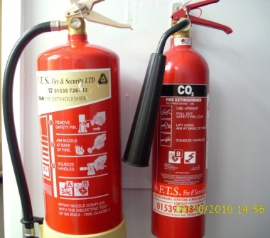
Extinguishers
Foam
CO₂
Fire extinguishers are placed at strategic locations, painted red in line with EC legislation
Notes:
Two types of extinguisher in use across the Trust.
Foam – Description; red with cream panel. For use on Class A or B fires (general use). Operates by cooling and smothering.
CO2 – Description red with black panel, tapered discharge horn. For use on electrical risk. Minimal damage when used, noisy, operates by excluding oxygen. Risk of re-ignition.
Should be wall mounted – not to be used as door prop.

Slide 29
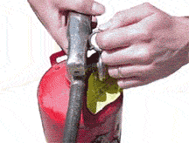
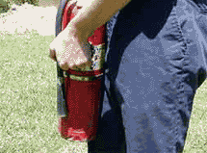
Extinguisher Operation
P.A.S.S Method
P – Pull Safety Seal and Pin
A – Aim at base of fire
Notes:
Describe PASS method.

Slide 30
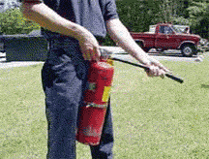

Extinguisher Safety
P.A.S.S Method
S – Squeeze the lever
S - Sweep from side to side

Slide 31

Fire Fighting Action
Sound the fire alarm
Do not use the extinguishers unless
  The fire is small and you are confident
  Trained and It is safe to do so
  Otherwise leave the building by the designated exits closing all windows and doors as you leave.
Notes:
Always sound the fire alarm
Be aware fire extinguishers only last 10 – 15 seconds CO2, 75 seconds water/foam, make sure your first shot is on target (efficient use).
Make sure you don’t blow burning papers out of wastebasket fires, stand back about 2 metres.
Don’t attempt to fight a fire that is too big, can’t be put out easily or involves burning gas.

Slide 32
Dangers of Fighting
Approaching the fire itself
Smoke
Being trapped by the fire
Bigger than you expected!
Gases
  Cylinders
  Aerosols
  Piped systems
Notes:
Describe hazards when firefighting. This is a last resort as attention to patients should be the priority.

Slide 33
Summary
Operate alarm
Staff to call the fire service (999)
Evacuation
Assemble at RVP
Roll call (Fire Register)
Firefighting Equipment
Attack a fire only if safe to do so!
Notes:
Fire may be discovered by seeing it, smelling it or hearing it. The alarm must be raised at once and the fire brigade called.
As soon as the alarm is raised, leave the building by the quickest, safest route. Don’t wait to collect any belongings but if you have any specific tasks e.g. turning or switching off heat generating equipment in your area, do them quickly and leave the building as soon as you can.
Help people who don’t know their way around such as visitors and those who are disabled, have impaired vision or hearing.
Close doors behind you. This will help stop the spread of fire, smoke and heat.
Don’t use lifts unless they are special evacuation lifts designated by a fire officer in accordance with special procedures for the disabled.
Go to the fire assembly point. Make sure all your colleagues are accounted for (a fire warden may conduct a roll call) and tell the person in charge if anyone is missing.
Do not return to the building unless told by the person in charge it is safe to do so.
REMEMBER, ONLY ATTACK THE FIRE IF IT IS SAFE TO DO SO!

Slide 34
Other Issues
Call Challenge Procedure
Vertical Evacuation
Safe Refuge Areas
General Fire Safety Training - Drills

Slide 35
Introduction
Heath & Safety Induction
This induction covers the safety and environmental rules that you must follow when working on this project.
Failure to comply with any safety and environmental rules (as listed in the following slides) could instigate formal disciplinary proceedings against employees, which may result in dismissal from TSO.
TSO is committed to achieving and maintaining the highest standards of health, safety and welfare at all times.
We are committed to protecting all site workers and visitors and members of the public..

Slide 36
Introduction
Heath & Safety Induction
There is nothing that needs to be done that we cannot take the time to do safely.
We plan, manage, conduct and supervise all our work in compliance with legislation and best practice.
We want to ensure that all people have a clear understanding of their responsibilities.
Everyone has a legal duty to contribute towards safe working and a safe site.

Slide 37
Introduction
Heath & Safety Induction
Please pay attention to the information provided during the next few slides.
The induction is important as all sites are different and have a wide range of hazards which will often change as the site develops.
The following slides provide vital information on the risks present, and site specific rules that you must comply with.

Slide 38
JMS Project Personnel
TSO MD Director | Dave Pattinson
Director | Stacey Vivian
General Manager | Alan Snelson
H&S Adviser | Dave Pattinson
Environmental Adviser | Dave Pattinson
Contact telephone numbers are displayed on notice boards.

Slide 39

Site Rules
Heath & Safety Induction
It is a requirement on this Project that the following rules be fully complied with:-
All persons attending site must undergo a Site Induction on their 1st site visit.
All personnel and visitors must sign IN AND OUT of site.
All mandatory PPE must be worn at all times whilst on site, or in the site compound, with the exception of non-PPE designated areas

Slide 40
Use of Vehicles on Site
Heath & Safety Induction
The site speed limit is set by law.
All vehicles must reverse park in main car parks.
All public road speed limits to be adhered to at all times. Some areas have 20MPH speed limits , so please exercise caution.
Follow traffic routes and be aware of pedestrians who may also be using the site..
Reversing lorries must have banks man.

Slide 41
Welfare Facilities
Heath & Safety Welfare
The toilets are located in the site compound. There are additional toilets at the end of the Offices.
The canteen is located in the site compound. There is an additional canteen area at the end of the offices
Please leave the welfare facilities in a clean condition.
There are ground hog units on site, please keep tidy and report any faults immediately.

Slide 42
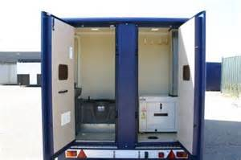
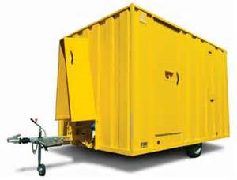
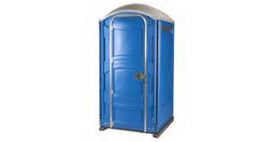

Welfare Facilities
Heath & Safety Induction out on site
Type of Welfare unit in use.
Supplementary portaloos may be utilized , please keep these tidy and report any problems immediately.
The units are serviced once a week and topped with water.
Do not to empty any waste cartridges from Vans

Slide 43
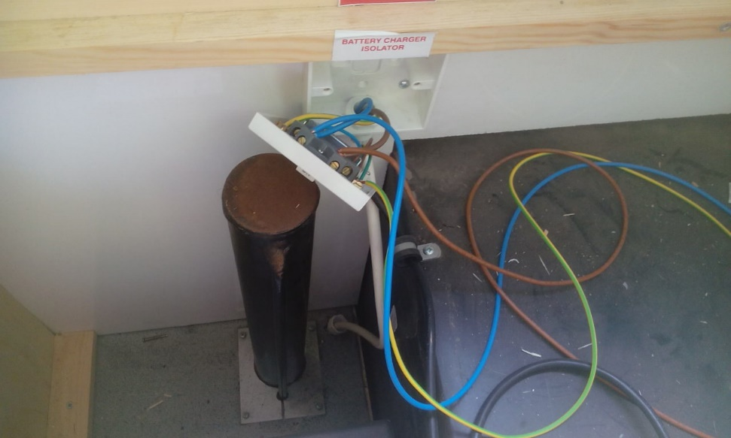
Welfare Facilities
The welfare units on site are ECO units
These are powered by a generator and solar powdered battery packs
The generator only needs to be run when 230v equipment is used
This will switch off after one hour max
At all other times the 12v battery will suffice.
Do not attempt to alter any settings or electrical fixings.

Slide 44
First Aid & Fire Reps & Facilities
Heath & Safety Induction
Your Site First Aider is:- See notice boards
Your Site Fire Wardens are:- See notice boards
Method of Alarm is:- Hard wired system (detectors & sounders) in the office area
Air horns in use throughout canteen/drying room area and on site
First Aid Box / Eye Wash Kits located in:- Mess Room/Reception/Stores and COSHH store and on site
Fire Extinguishers are located at:- Locations throughout Offices &Site
Fire emergency muster point is located:- Car park to the front of the offices.

Slide 45

Emergency, Accident & Incident Reporting Procedures
Heath & Safety Induction
For small fires use extinguishers if confident & competent, if not raise alarm by using nearest fire call point/Air horn ,Then report location and nature of incident to supervisor
Prior to starting work ,familiarize yourself with locations of emergency stations at your work area
In the event of a personal injury accident, the accident book will be filled out. (This is Held by The SHE advisor)
Following any accident or incident, the HSE Advisor, the Site Manager, the Project Manager and Client Site Rep will be informed and the details recorded on site.
Any plant or equipment involved in an accident or incident should be left at the scene, and the area fenced off.

Slide 46
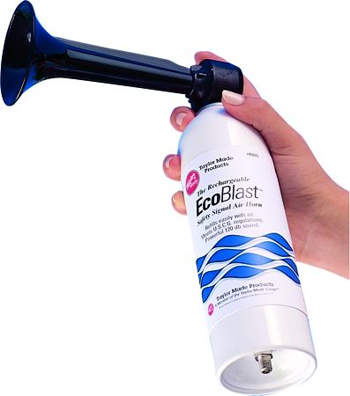

Emergency Evacuation
  The emergency alarm for this site is:
  One long blast of the air horn
  (located at various locations around the site)
  Office is hard wired alarm. Test is 0630 AM Tuesday morning)
  In the event of the alarm sounding at any other time everyone must stop work immediately and go to the site muster point.

Slide 47
Hospital Location
Heath & Safety Induction
There is an A&E hospital.
Royal Lancaster infirmary ashton road Lancaster.
The nearest hospital routes are shown on the site notice boards and in Emergency Stations.

Slide 48


Drugs and Alcohol
Heath & Safety Induction
Anyone found in the possession of illegal drugs or under the influence of alcohol will be immediately removed from the site.
If you are taking any prescribed medication, please inform the Health and Safety Advisor at the end of this induction.
Note: Drug and alcohol testing will be carried out on this site.
In the event of an accident or Incident you may be asked to provide a breathalyser test and D& A swab.

Slide 49

Phones and MP3 Players
Heath & Safety Induction
The use of mobile phones and MP3 players affects your ability to listen to safety critical instructions or alarms.
MP3 players (or similar) are not permitted on site.
Mobile phones must not be used whilst working. Phones should be switched off or in silent mode.

Slide 50
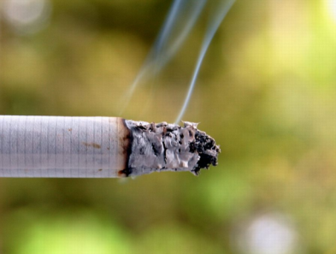
Smoking
Heath & Safety Induction
Smoking is permitted in designated areas only
All spent cigarettes and matches are to be placed in the bins provided

Slide 51

PPE Requirements
Hard Hats
Hard hats must be worn at all times and be in date.ie less that 3 years old.
Clothing
Flame-retardant work-wear / overalls & long sleeved yellow hi-vis or jacket
Eye Protection
Safety glasses or Safety sun glasses are mandatory
Hearing Protection
Where mandatory signage is displayed.
Other Hearing and eye protection should be worn if identified within the risk assessment

Slide 52
PPE Requirements
Footwear
Safety footwear with ankle protection.
Rigger boots / Redwings are NOT allowed.
Gloves Gloves appropriate for the task must be worn where required
Banksmen
Banksmen to wear identifying hi-vis.or hard hats

Slide 53
PPE Requirements
Failure to wear PPE will result in disciplinary action.
PPE must be in good condition and fit for purpose.

Slide 54
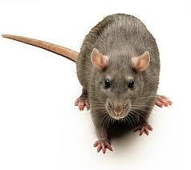
Weil’s Disease /Leptospirosis
Left over food encourages
Rats ….
Rats spread Weil’s Disease
Never attempt to handle rats
Do not eat or drink anywhere rats are known to have been or are present
Wear hand protection whilst working in infected areas
Wash thoroughly before eating/drinking/smoking

Slide 55

Specific Site Hazards
Working close to mechanical plant & equipment.
Working at heights/ Walking past excavations .
Security / vandalism.
Slips, trips & falls.( Uneven surfaces are present in most area and timber bog mats which are uneven, subject to wear and have openings for lifting eyes)
Noise.
Working in close proximity to the general public.
Working around demolition / dismantling works.( Keep clear of all areas as work may be unfinished )

Slide 56
Waste
Heath & Safety Induction
All waste must be put in the correct skip.
Waste must be segregated.
Different types of hazardous waste can not be mixed together e.g. oily rags must be separate from paint tins.

Slide 57

Environmental Issues
When Refuelling
Refuel only at designated area
Use a drip tray
Ensure Spill Kits are available in re-fuelling area
In the event of a spill clean up using spill kit and REPORT it immediately
Designated refuelers only : Names/photos displayed at refuel point,
Waste Management
Ensure waste is segregated as per the Waste Management
The Site Waste Reps are as detailed in the stores.
Noise Management
Keep noise on site to a minimum
Turn off plant & equipment when not in use AND REMOVE THE KEYS

Slide 58
Environmental Issues
Dust
If excessive dust is being created stop work and inform the supervisor
Damp down dust with water
Conservation Consent
The worksite is not in an area of conservation. A consent is not required for the works
Complaints
All complaints shall be dealt with via the NWR help line, detailed in the Noise letter distributed to all residents in the surrounding area. Any complaint shall be logged on the Murphy complaints form and the SHE Advisors informed.
Nesting Birds
Identification of protected species shall be correctly monitored and their movement recorded by a competent person.

Slide 59
Feedback Cards
Feedback Stations are located throughout the site.
Please raise feedback whilst on site.
Providing feedback on hazards allows us to put controls in place to prevent accidents from occurring.
REMEMBER to report all accidents, incidents or near miss occurrences.

Slide 60
Thank You
Any Questions?

