Slide 1
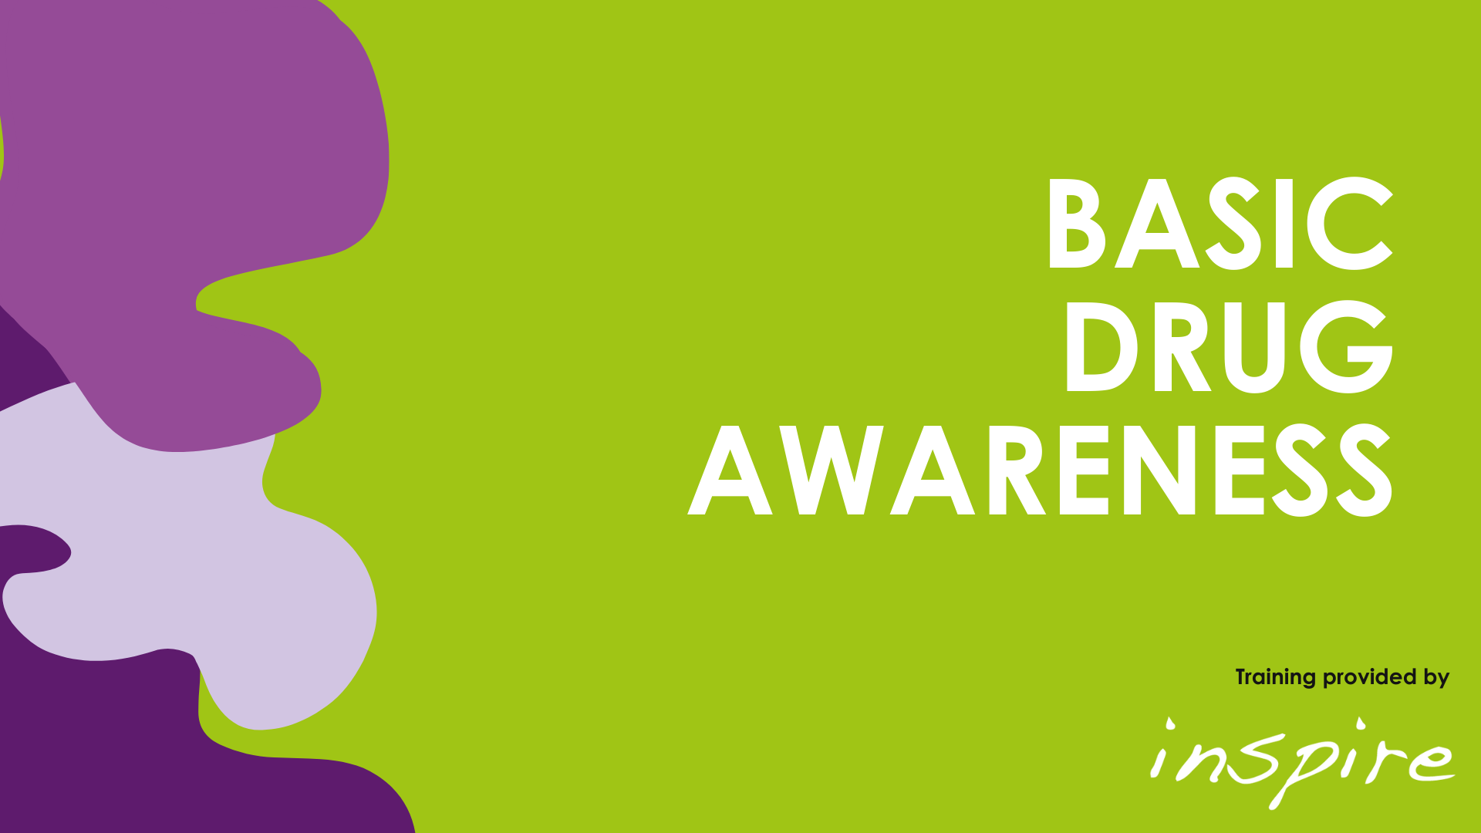
Alcohol & Drug
Awareness

Slide 2







Housekeeping

Slide 3

Welcome & Check In
Name
Role
Organisation
Objectives

Slide 4
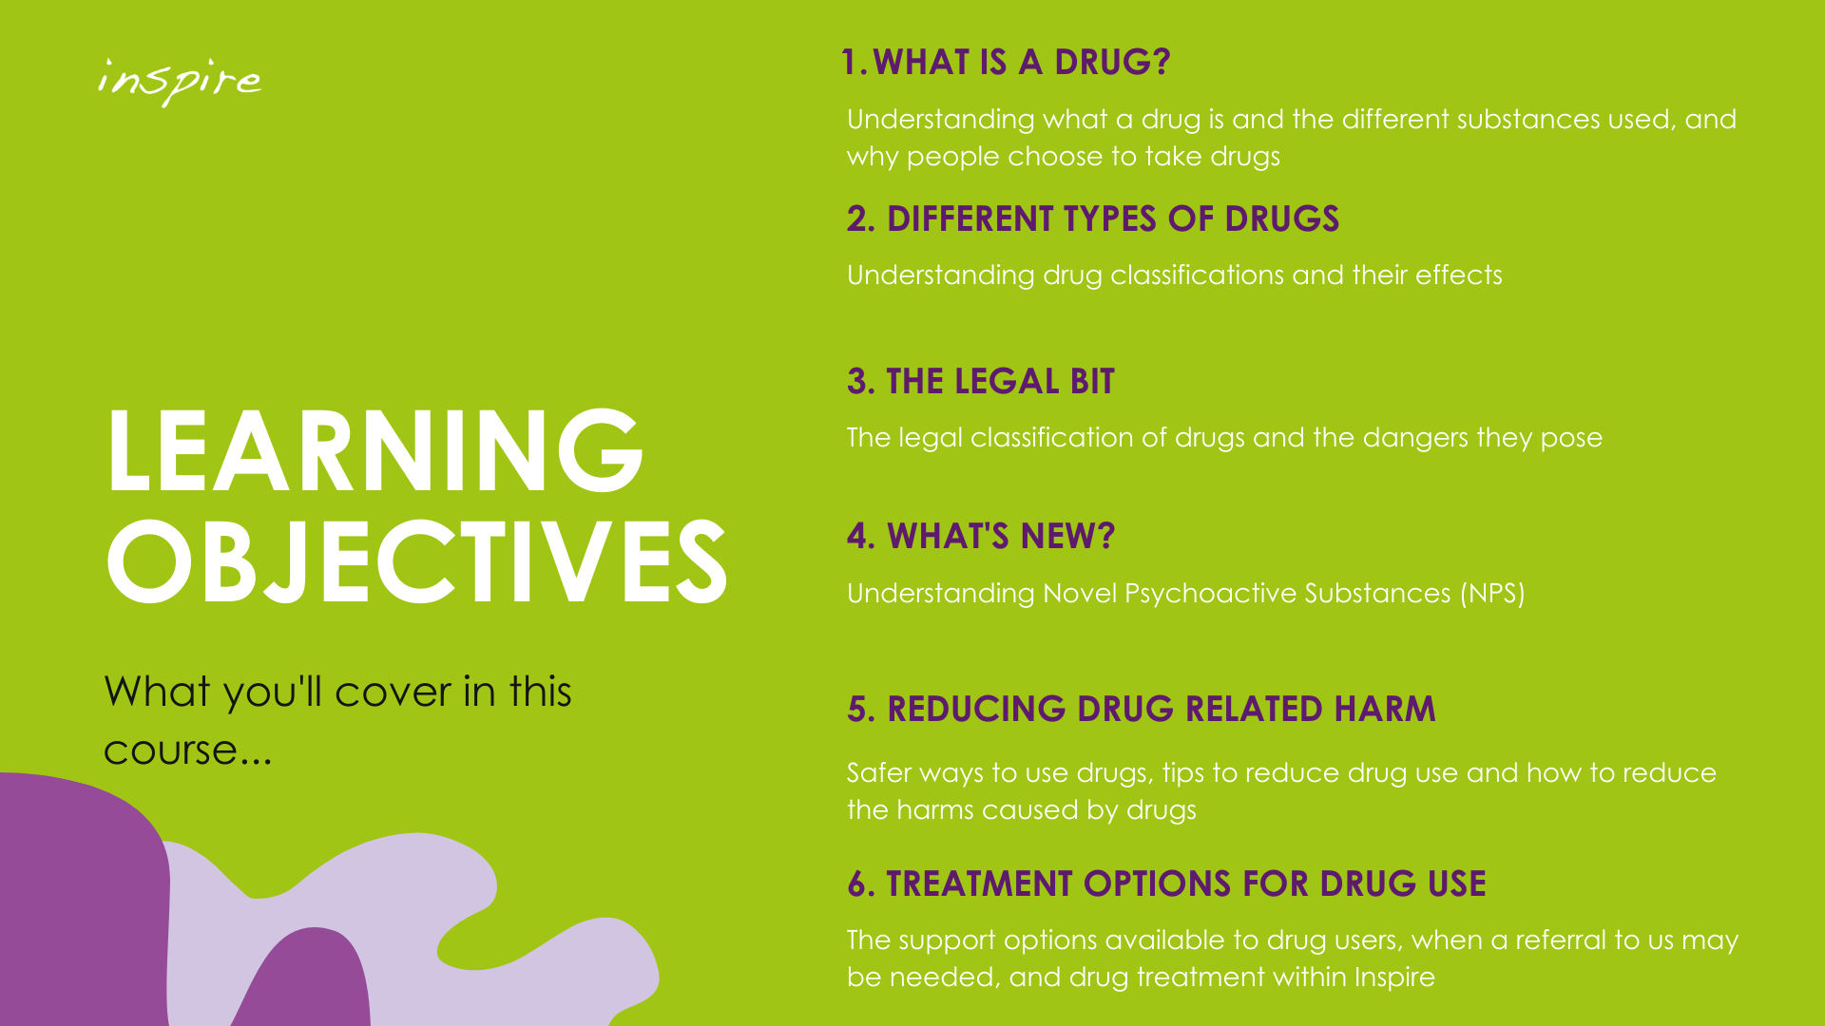

Slide 5
Unit Guidelines
14 units per week for women and men
No more than 8 units for males or 6 units for females in one single session
If you regularly drink as much as 14 units per week, it's best to spread your drinking evenly over 3 or more days
Notes:
In 2023, there were 10,473 alcohol-specific deaths (deaths wholly due to alcohol) in England, a 4.6% increase since 2022. This equates to a rate of 15.0 per 100,000 population in 2023. This was the highest rate for alcohol-specific mortality since the start of the data series in 2006 | OHID, UK
Office for National Statistics. (2018). Adult drinking habits in Great Britain, 2017 [dataset]. Accessed 30 June 2022. Available at: https://www.ons.gov.uk/peoplepopulationandcommunity/healthandsocialcare/drugusealcoholandsmoking/bulletins/opinionsandlifestylesurveyadultdrinkinghabitsingreatbritain/2017

Slide 6
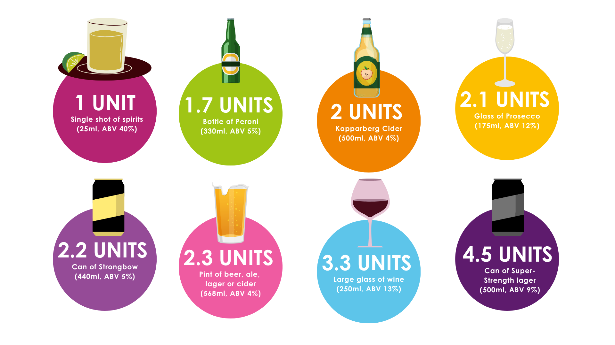

Slide 7

A.B.V. (Alcohol by Volume): is the amount of alcohol contained in a drink and is calculated as a % of the total volume of the drink.
1 - Multiply the total volume of the drink (in millilitres) by its alcohol volume (ABV%)
2 - Divide the result by 1,000 = Units
Notes:
ABV stands for Alcohol by Volume, which is the standard way of measuring the amount of alcohol in a drink. It's calculated as a percentage of the total volume of the drink.

Slide 8
Activity

Slide 9
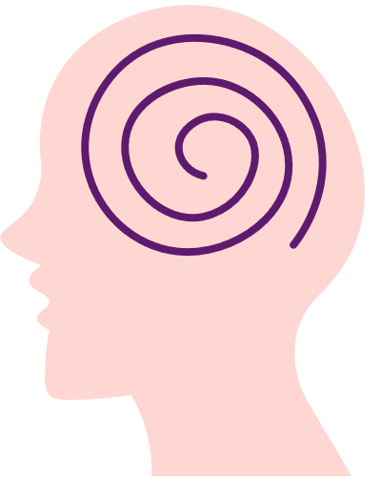

Impact of Alcohol Use
Psychological
Physical
Insomnia
Regret
Vitamin deficiency
Memory
loss
Lowered inhibitions
Liver damage
Depression
Premature ageing
Memory
loss
Trips & falls
Osteoporosis
Fear
Poor social skills
Throat & mouth
cancer
Anger
Dependency
Heart failure
Extreme emotions
Panic attacks
Impaired sexual performance
Addiction
Violence
Poor immune system
Paranoia
Anxiety
Nerve damage
FASD in babies
Wernicke-Korsakoff Syndrome
Breast cancer

Slide 10

Benefits of Reducing
Psychological
Improved mood
Better relationships
Reduced risk taking
Help with depression and anxiety
Improvement in cognitive function
Physical
Reduced risk of disease
Lower blood pressure
Fewer injuries
Improved sleep quality
Increased libido
Improved energy levels
Weight loss
Improved skin condition
Better gut health
Financial
More disposable income
Pay off debts
Keep up to date with rent
Less financial stress
Discover new hobbies
Notes:
Disease – Heart disease, liver disease, cancers, and stroke

Slide 11


A chemical substance used in the treatment, cure, prevention, or diagnosis of disease or used to otherwise enhance physical or mental well-being.
(Dictionary.com)
Defining what a ‘drug’ is
Any natural or artificially made chemical that is taken for pleasure, to improve someone’s performance of an activity or because a person cannot stop using it.
(Cambridge Dictionary)
Notes:
Definition

Slide 12

The term ‘drug’ covers medications prescribed by a doctor, sold by a pharmacist or procured illicitly and used for recreational purposes. There is crossover. Some prescribed drugs are used (or misused) for their psychoactive properties.
Drugs can be ingested into the body in various ways - smoked, inhaled, injected, swallowed, rectal, sublingual.
Effects may be different according to how the substance has been taken.
Defining what a ‘drug’ is
Notes:
Common prescribed drugs that tend to be misused can be opiate medication i.e Co Codamol, tramadol, codeine etc.
Pregabalin, Gabapentin, Benzos i.e. Diazepam.
Inspire are seeing a lot of referrals for OTC medication that is being abused i.e. Nurofen plus, Solpadine extra and Panadol ultra, the opiate is codeine phosphate in the plus, extra and ultra wording. Anything without Plus, extra or ultra does not contain opiate.
E.G lorry driver buys 2 boxes 16 tablets therefore is taking 32 tablets per day, having to go to different pharmacies and is opiate dependant and would experience withdrawals if he was to go without. We would in these case prescribe OST.
Its common for people in addiction to sell their own to other service uses to abuse

Slide 13
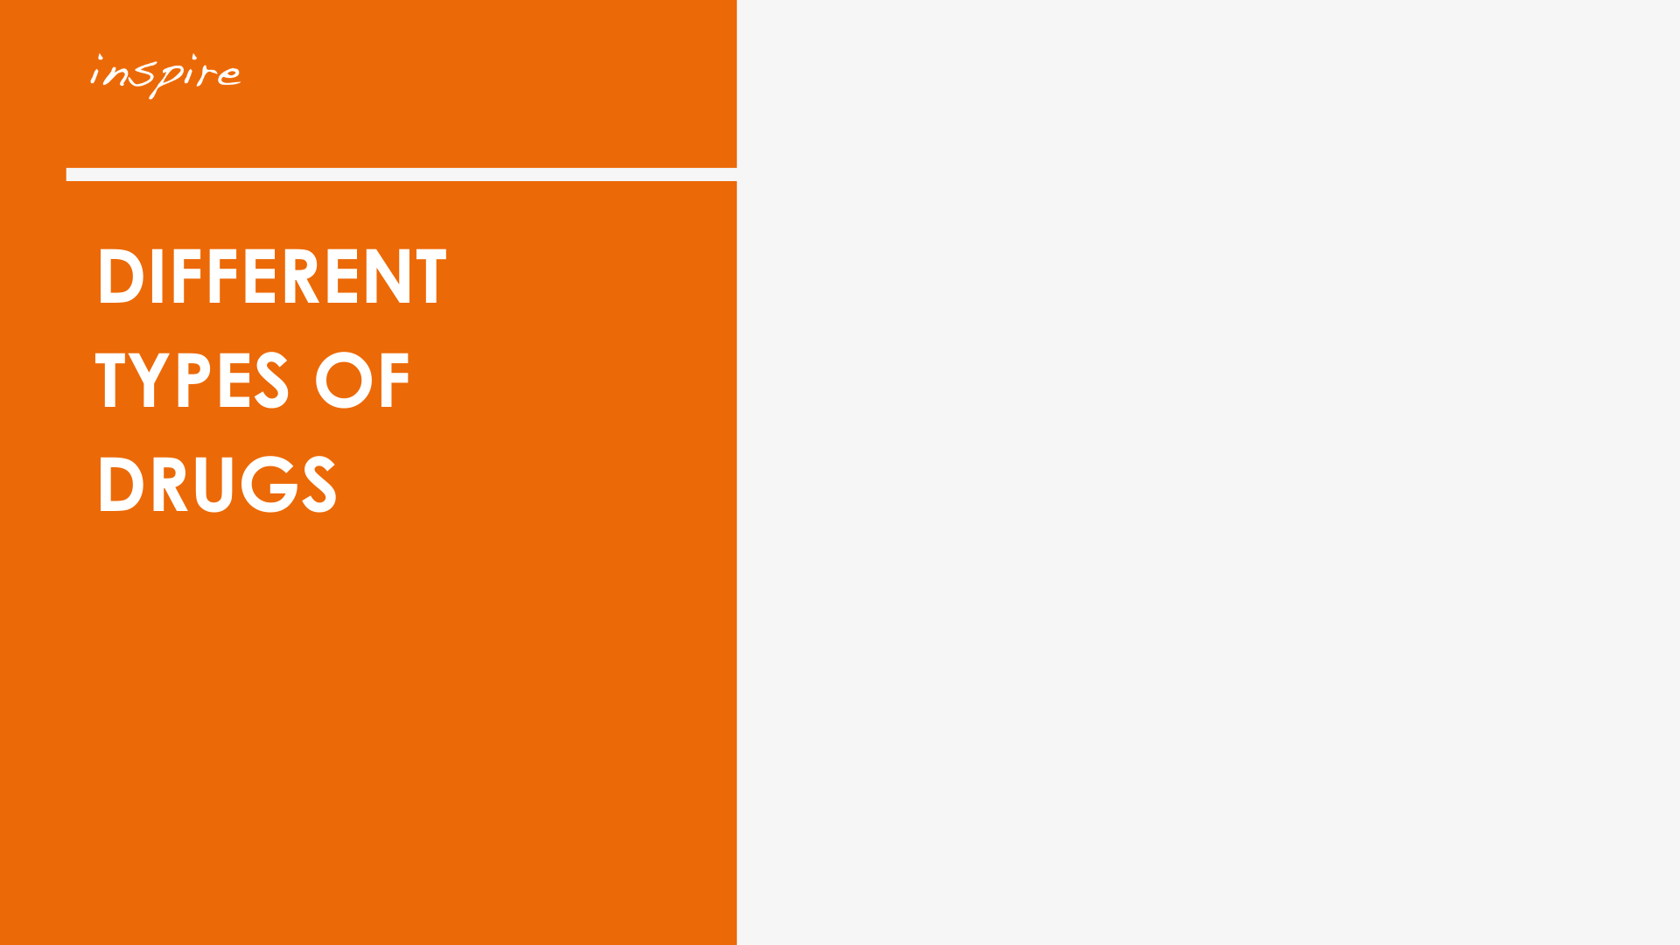

TASK
Discuss and list the reasons why people might use drugs.
Why do people use drugs?

Slide 14
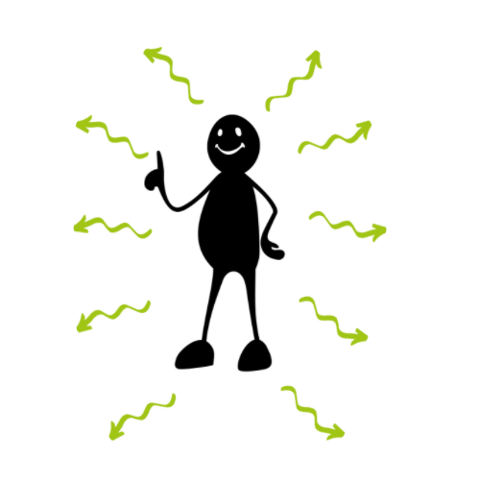
Pleasure
To fit in
Enhance other activities (music, dancing, sex)
Curiosity
Counteract withdrawal effects
Peer Pressure
Why do people use drugs?
Escape reality
Weight loss
Medication
Concentration

Slide 15
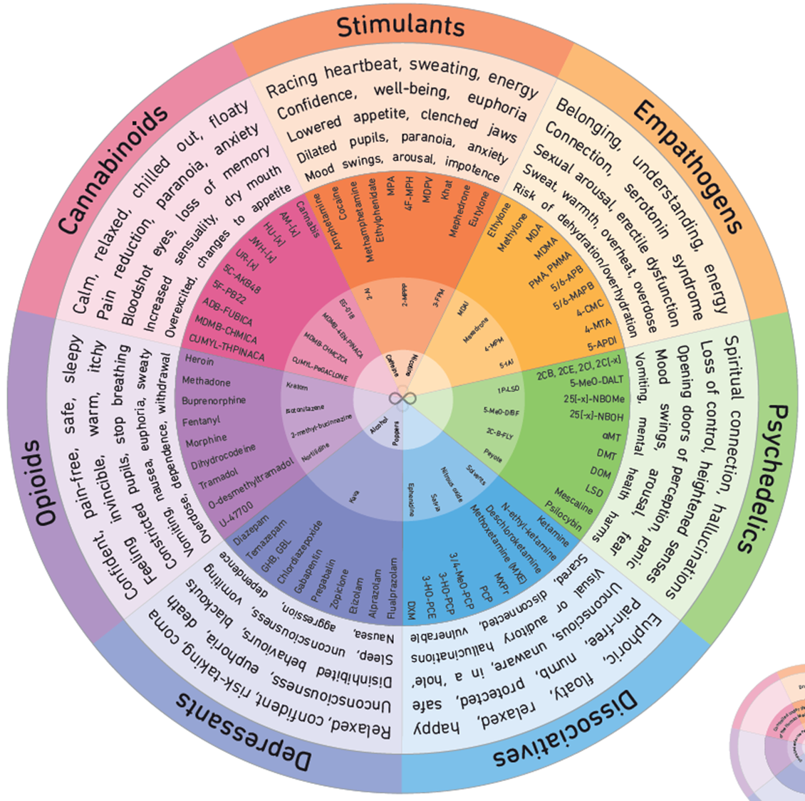
Drug Categories
Notes:
www.thedrugswheel.com

Slide 16
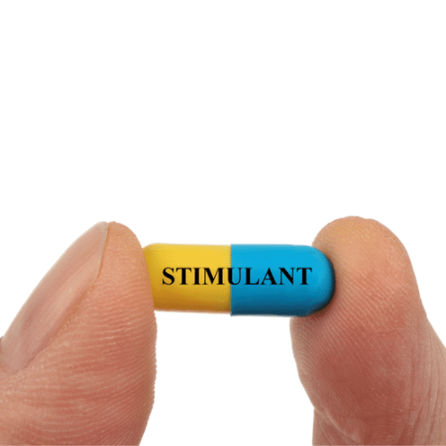
Notes:
Alcohol & Drug Foundation
Stimulants are a class of drugs that speed up messages travelling between the brain and body. They can make a person feel more awake, alert, confident or energetic.
Uppers, pep pills, speed

Slide 17

Cocaine/Crack Cocaine
Amphetamine
Herbal Ecstasy
Examples of stimulants
Nicotine
Caffeine
Energy drinks
MDMA, Ecstasy
Notes:
MDMA also a hallucinogen
Mephedrone – Empathogen/stimulant
Bubble/Meow Meow – Synthetic cathinone stimulant
Herbal Ecstasy – Stimulant effect. Does not contacin MDMA

Slide 18
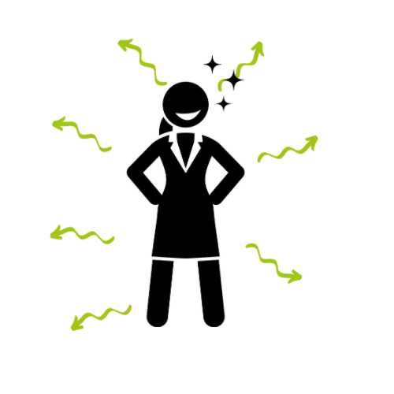
Desired Effects
Energy
Confidence
Enhances other activities
Socialise
Stimulants
Lose weight
To stay awake
Elevate mood
Notes:
When do u think someone is likely to use stimulants?
Answers; Lose weight, at a club or whilst drinking,
What kind of desired effect do u think someone will get from taking stimulants?

Slide 19
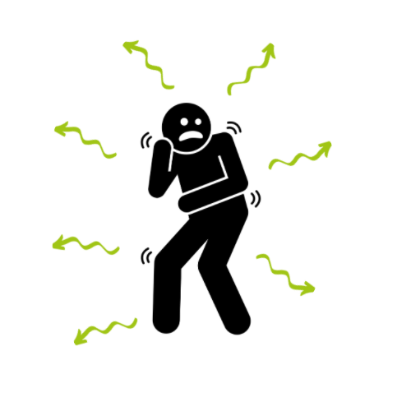
Negative Effects
Anxiety
Palpitations
Stroke
Paranoia
Stimulants
Heart attack
Psychosis
Overdose
Notes:
What do u think the negative effort a stimulant will have on someone's mental and physical health?

Slide 20
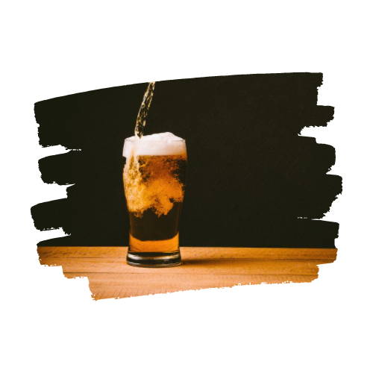
Drug Categories
DEPRESSANTS
Notes:
Depressant substances reduce arousal and stimulation. They affect the central nervous system, slowing down the messages between the brain and body.

Slide 21
Benzodiazepines
Alcohol
Co-codamol
Tramadol
Fentanyl
Examples of depressants
GHB/GBL
Depressants
Morphine
Nitazines
Codeine
Heroin
Notes:
Can you name me some depressant drugs?
Kava - made from the root or stump of the kava shrub
Oxycodone - opioid
GHB and GBL can reduce people’s inhibitions, and some people take the drugs to have more intense sex.
Xanax - Benzo
Fentanyl is a synthetic opioid that is 50-100 times stronger than morphine.
Fentanyl is big in USA but is finding its way into the UK and there has been a number of deaths in the UK were heroin has been cut with Fentanyl. This is a big overdose risk as many SU aren’t aware that this can be in heroin and it is a strong opiate. Its generally prescribed to cancer patients due to how strong it is.

Slide 22
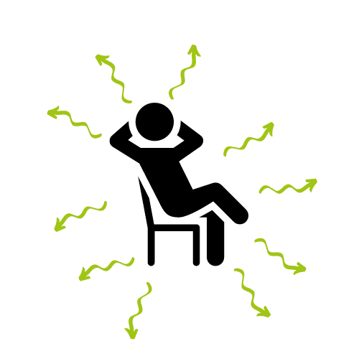
Desired Effects
Euphoria
Pleasure
Reduce anxiety
Happy
Escape
reality
Depressants
Pain relief
Slow reactions
To sleep
Counteract withdrawals
Notes:
Why do people misuse depressant drugs?

Slide 23
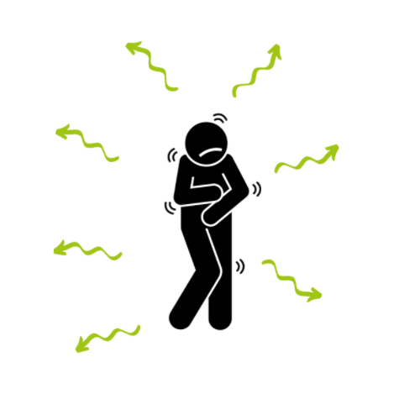
Negative Effects
Impaired coordination
Death &
Overdose
Coma
Breathing difficulties
Depressants
Unconsciousness
Nausea and vomiting
Blackouts & memory loss
Notes:
Depressants affect the central nervous system, slowing down the messages between the brain and body. They can affect concentration and coordination and slow down a person's ability to respond to unexpected situations.
This will have an impact on someone's driving ability and needs to be considered when taking a depressant drug / prescription.

Slide 24
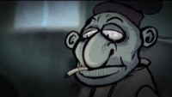
Wobbly Stan the Benzo Man from Redcar
Notes:
(72) Wobbly Stan the Benzo Man from Redcar – YouTube A film based on the Benzo experiences of users in Redcar featuring the voice of Mark Benton.
Benzodiazepines are a group of drugs that are prescribed by doctors for sleeping problems and to help reduce anxiety.
They are usually small round tablets and come in different strengths (2mg pills are white, 5 mg pills are yellow and 10mg pills are blue).
When sold on the street they are known as blues, benzos, valies, diazies, wobblies, etc.
Much of what is sold by dealers or brought from the internet are fakes. So you never really know what you are buying or how strong it will be.

Slide 25

Psychedelics
Notes:
Psychedelics (also known as hallucinogens) are a class of psychoactive substances that produce changes in perception, mood and cognitive processes.

Slide 26
2C-B
LSD
Examples of hallucinogens
‘Magic
Mushrooms’
Hallucinogens
Ketamine
Salvia
Cannabis
Notes:
Ask the participants to name some of the drugs?
Salvia - A herb from the mint family and can cause brief, intense psychedelic experiences. Sublingual absorption, smoked or in tea.
2C-B Stimulant effects
Psilocybin AKA magic mushrooms
Ketamine – Psychedelic effects
Herbal Ecstasy.
Cannabis has been historically classified as a hallucinogen. However, subjective cannabis effects do not typically include hallucinogen-like effects but in some users have reported: Feeling of paralysis, Out-of-body experience, Floating above the body, Dream-like euphoria

Slide 27
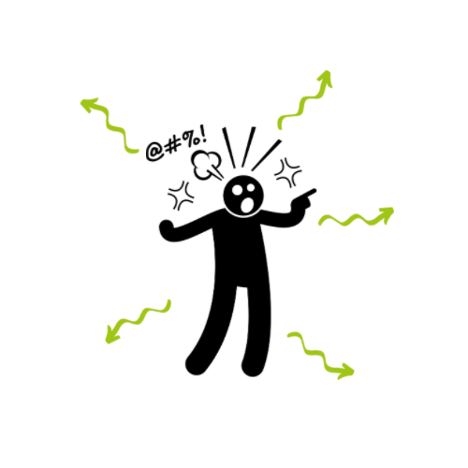
Desired Effects
See colours & shapes, hear sounds and taste
Pleasant hallucinations
Feeling of connectedness
Hallucinogens
Enhanced experience of art, music etc.
Spiritual powers
Notes:
What do you think some of the desired effects are from taking Hallucinogenic’s?

Slide 28
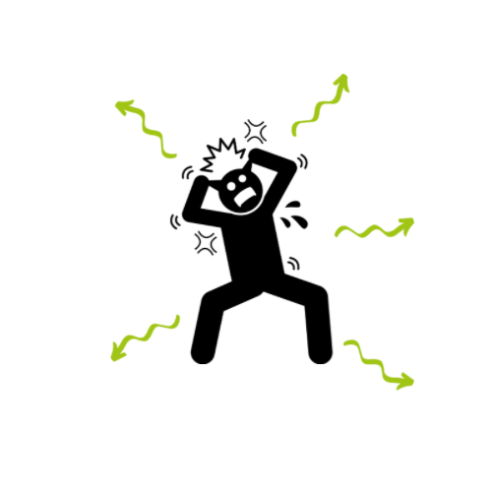
Negative Effects
Paranoia &
psychotic symptoms
A bad trip
Inability to move
Hallucinogens
Panic, Mood swings & Anxiety
Seizures
Notes:
What do u think some of the negative effect can be?
Pls add Inability to move, Mood swings, Memory loss

Slide 29
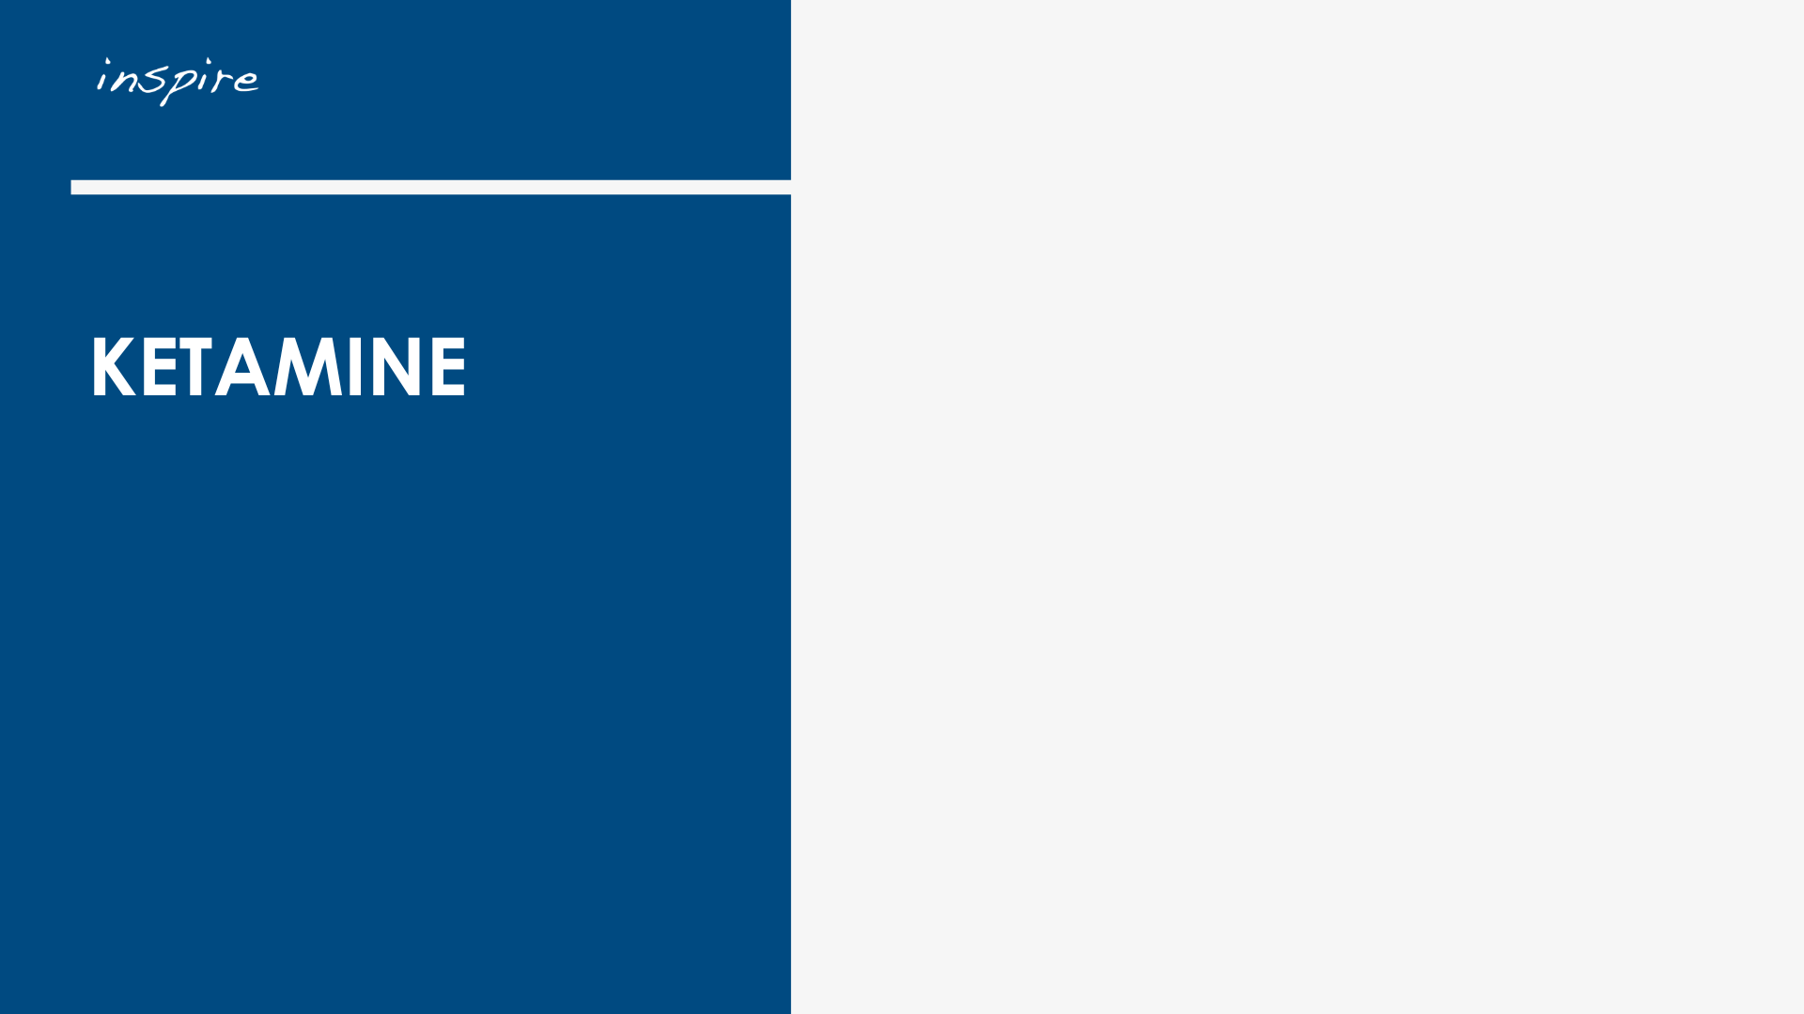
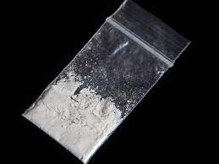
‘Ket’ ‘Special K’ ‘Kit-Kat, Super K’
Notes:
From:Home Office and The Rt Hon Dame Diana Johnson DBE MP
Published8 January 2025
The prevalence of the drug in England and Wales has risen significantly in recent years. In the year ending March 2023, an estimated 299,000 people aged 16-59 had reported ketamine use in the last year – the largest number on record.

Slide 30
What is Ketamine?
Ketamine is described as a "disassociate anesthetic." It interferes with signaling between brain and body, reducing awareness and sensitivity to pain.
Users report feeling disorientated, with some hallucinogenic experiences. Some people feel euphoric and experience a feeling as though travelling along a tunnel towards a white light
Some users report intense "out-of-body" experiences
K-Hole
Ketamine is also utilised for pain control in hospitals.
Notes:
Disassociatives are a class of psychedelic drugs.

Slide 31
How its used?
By snorting it as a powder
By injecting it
By swallowing it as a tablet
By bombing
Notes:
Most people who take powder ketamine will snort it. In the UK, snorting is the most common way to take ketamine.
People who regularly use ketamine sometimes inject it to get a bigger hit. They usually inject ketamine into a muscle.
Some people swallow it in tablet form, but this is less common.
Some people ‘bomb’ it, which is swallowing the powder wrapped in a cigarette paper.

Slide 32
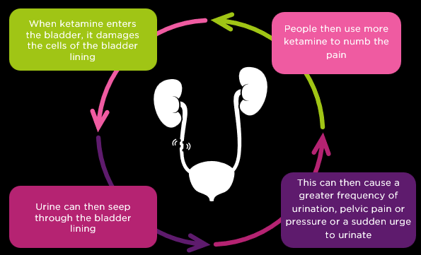
Physical effects
Sinus infections and nasal problems
Kidney and/or bladder damage
Ketamine cystitis
Urinary tract damage (trouble urinating, bleeding, needing to urinate excessively)
Abdominal & back pain
Combining ketamine with alcohol or other depressant drugs is extremely dangerous
Notes:
Bladder replacement

Slide 33
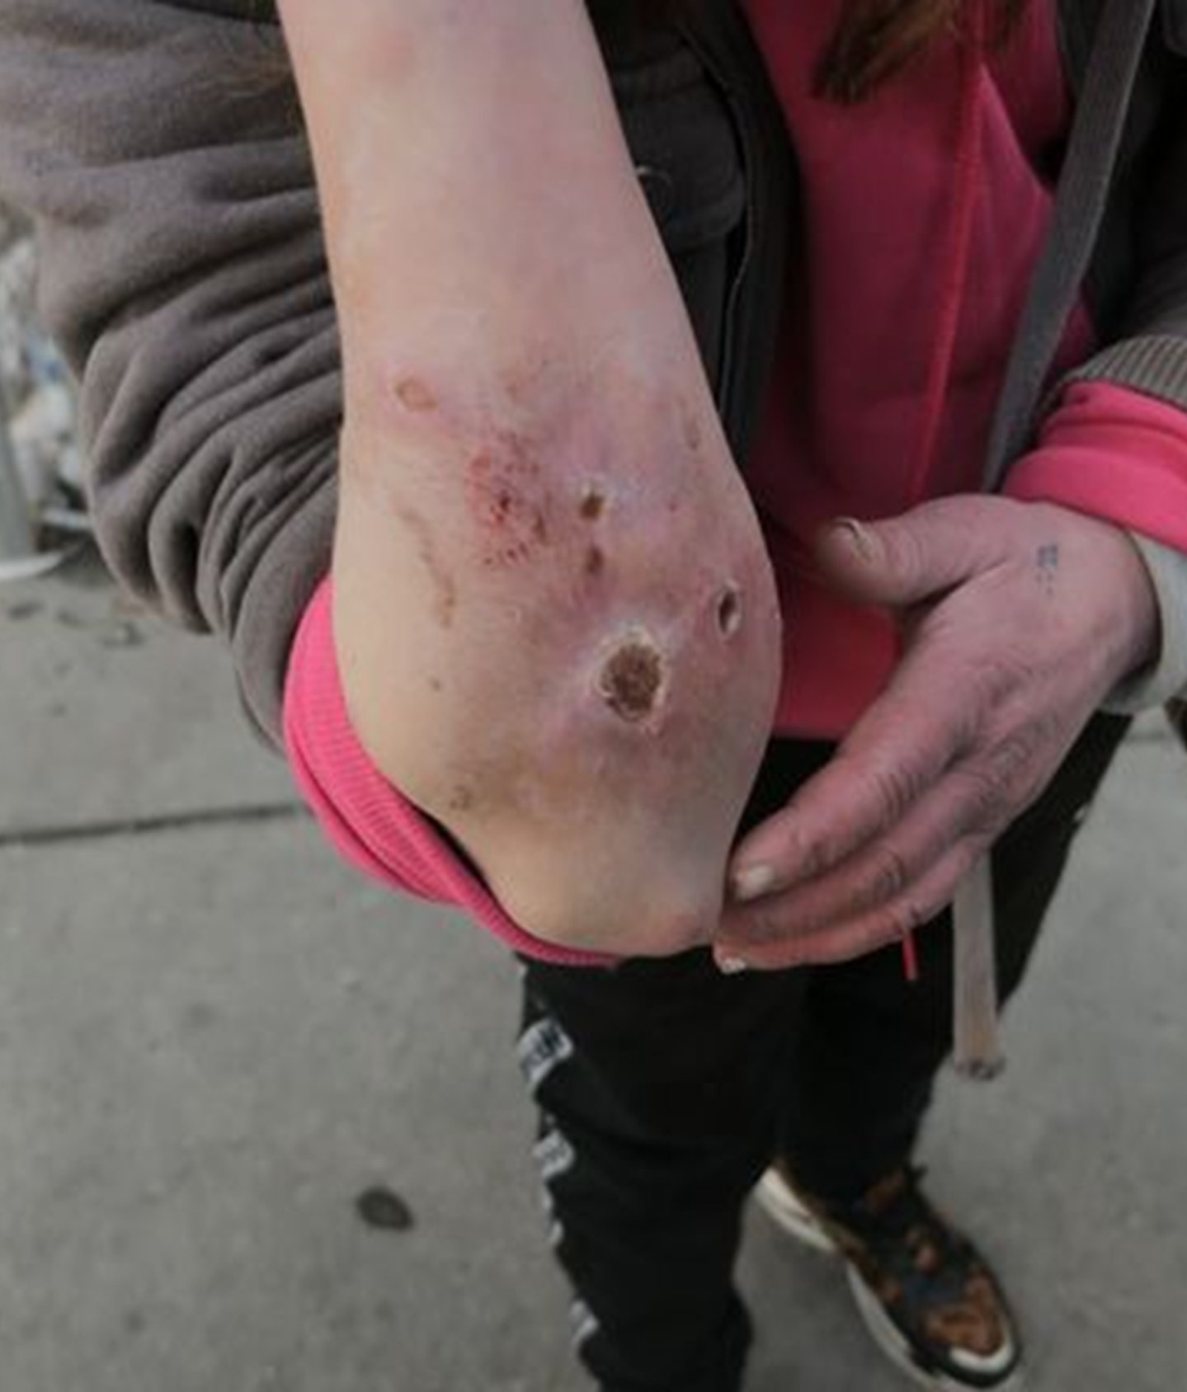
Psychological effects
Lack of cognitive ability
Change in memory
Delusional thoughts
Depression
Anxiety
Panic attacks
Psychosis
Recent Positive tests for Xylazine in Ketamine which causes open wounds

Slide 34

TASK
Label each substance:
Class A, Class B, Class C or Legal
Drug Classifications
Notes:
Task Break out rooms or groups.
No cheating!

Slide 35
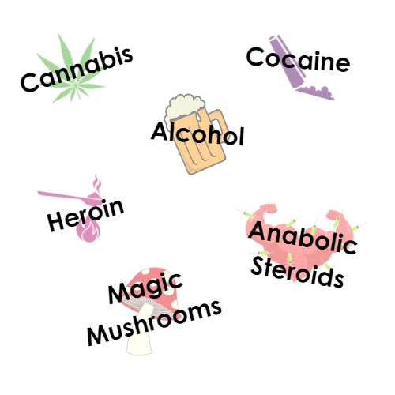
A
B
Legal
A
Drug Classifications
C
A

Slide 36
Drug Classifications
Source: The Lancet
Over the past few years research has started into the potential medical uses and benefits of certain substances controlled under the misuse of drugs act. There have been promising studies into the use of ketamine and psychedelics to treat depression, PTSD, addictions, anxiety in palliative care.
Notes:
Source: The LANCET
Green shows the harm to the user but the purple shows the harm to others.
Who may the others be? Partner, parents, children, friends, employer etc

Slide 37

NPS are drugs that are designed to replicate the effects of other illegal substances.
People may refer to these drugs as “legal highs,” but all psychoactive substances are now either under the control of the Misuse of Drugs Act 1971 or subject to the Psychoactive Substances Act 2016.
Novel Psychoactive Substances (NPS)

Slide 38

Cheaper
Bought on the internet or corner shops
Novel Psychoactive Substances (NPS)
A lot stronger
Advertised as LEGAL
Notes:
The term ‘legal high’s’ wrongly made users believe that these substances were safe to use as they would often come in branded packaging. NPS imitate and mimic the effects of drugs such as psychedelics, sedatives, depressants and stimulants, for example, cannabis, benzodiazepines, cocaine, and ecstasy.

Slide 39
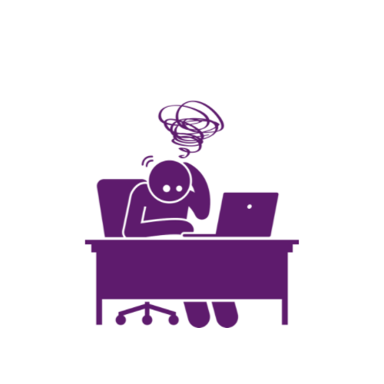
Some ‘Legal’ Highs
TASK – Can you name some legal high?
Bubble
Balloons
Plant Food
Drone
Novel Psychoactive Substances (NPS)
Spice
Black Mamba
Bath salts
M-CAT
N-Bomb
Notes:
N-Bomb A powerful hallucinogen, similar to LSD, sold as tiny squares of paper
Nitrous Oxide/Balloons/ Laughing gas are silver cannister that is inhaled Also called:
Balloons
Chargers
Hippie Crack
Laughing Gas
Feel like Relaxed, giggly, sound distortions and/or dizzy, anxious, paranoid.
People open the canister, transfer the gas into a container (usually a balloon), then inhale from the balloon.
It’s more dangerous inhaling directly from the canister. It can be hard to judge how many balloons to use. Too much nitrous oxide can make you faint, lose consciousness, or suffocate
Spice is heavily used in Blackburn & Manchester
Black Mamba - kidney injury, myocardial toxicity, seizures, and death.
Bath salts - synthetic cathinones

Slide 40
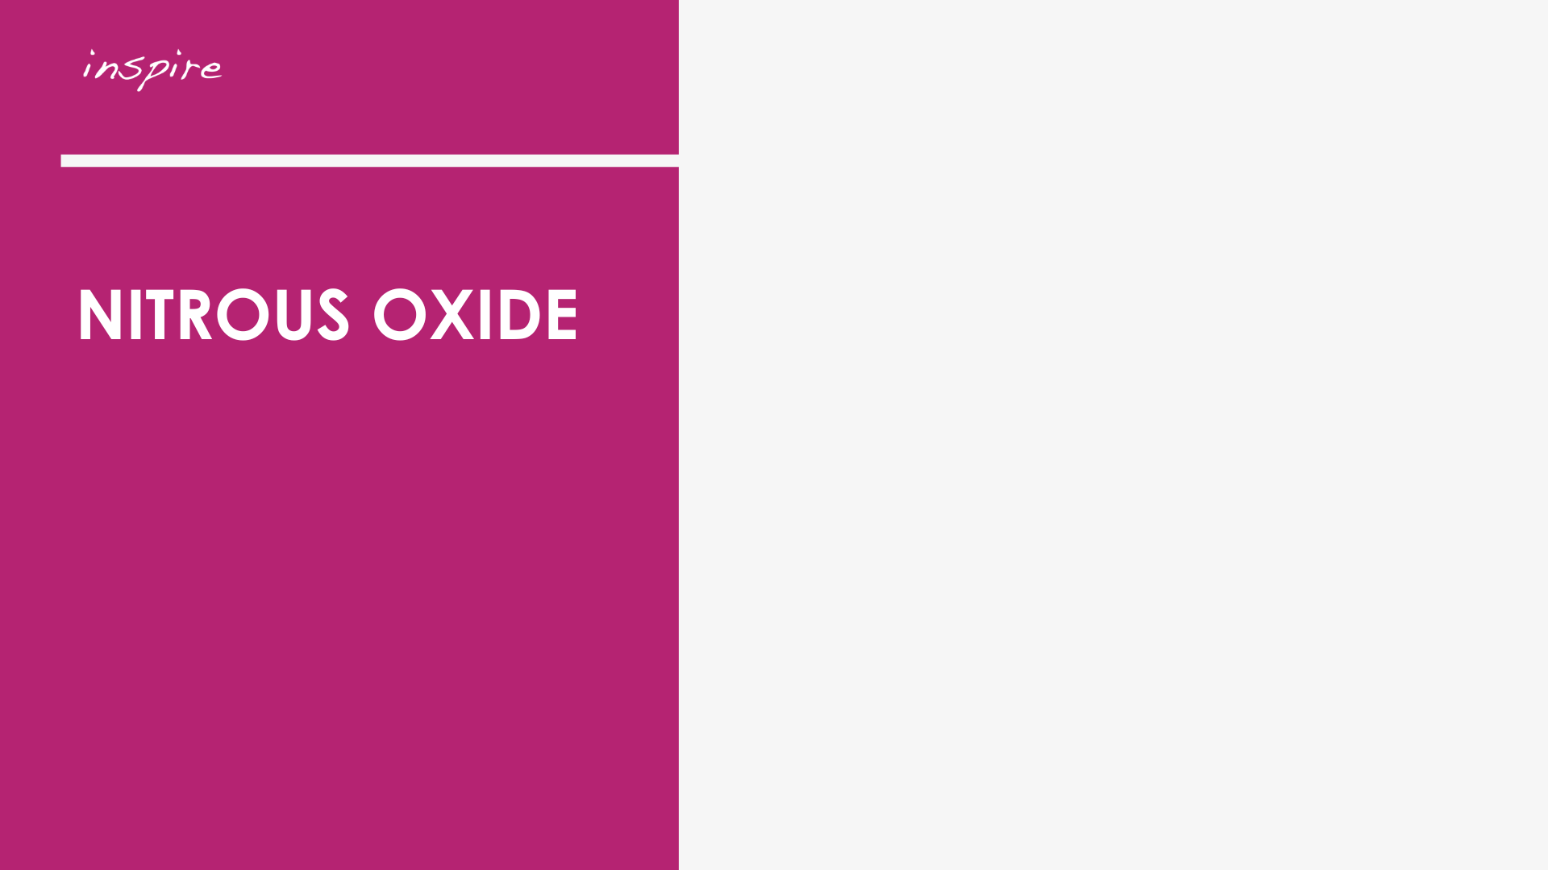
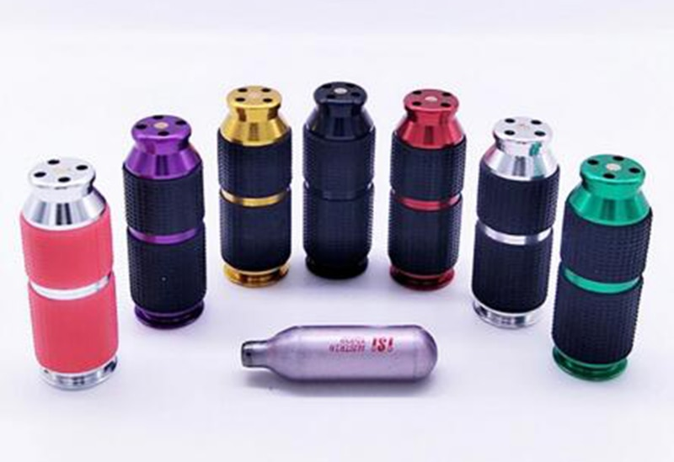
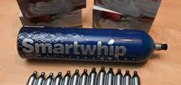
Taking Nitrous Oxide
Feelings of euphoria, relaxa`tion & calmness
Fits of giggles and laughter
Sound distortions and hallucinations
Nitrous Oxide Can Also:
Give you a severe headache
Stop you thinking straight
Cause short-lived but intense feelings of paranoia
Notes:
Balloons, Laughing Gas, Chargers, Hippie Crack, Whippet, Nang’s, Buzz Bombs, Happy Gas

Slide 41
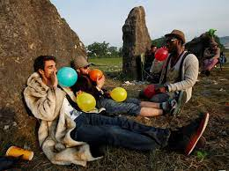
How long does it last?
It depends on how much you’ve taken, your size and what other drugs you’ve taken (generally 1-2 minutes)
It’s often taken in combination with other drugs, so it’s effects can be unpredictable as it depends which other drugs are taken with it.
It’s a short acting drug which can lead people to frequently re-dose and end up using more than they intended

Slide 42
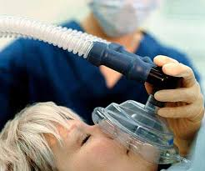
Who Else Uses It?
Medical professionals commonly use it for sedation or pain relief
Bakeries to make the perfect whipped cream and it can also be used to enhance flavour, prepare sauces, marinades and mousses.

Slide 43
Regular use can stop you forming white blood cells properly
Heavy use can lead to B12 deficiency causing nerve damage and even paralysis.
It can be hard to judge the amount to use safely resulting in loss of consciousness/injury/suffocation
Long term exposure can lead to infertility
Can cause frostbite to the lips, nose and throat if inhaled directly from the cannister

Slide 44


Slide 45
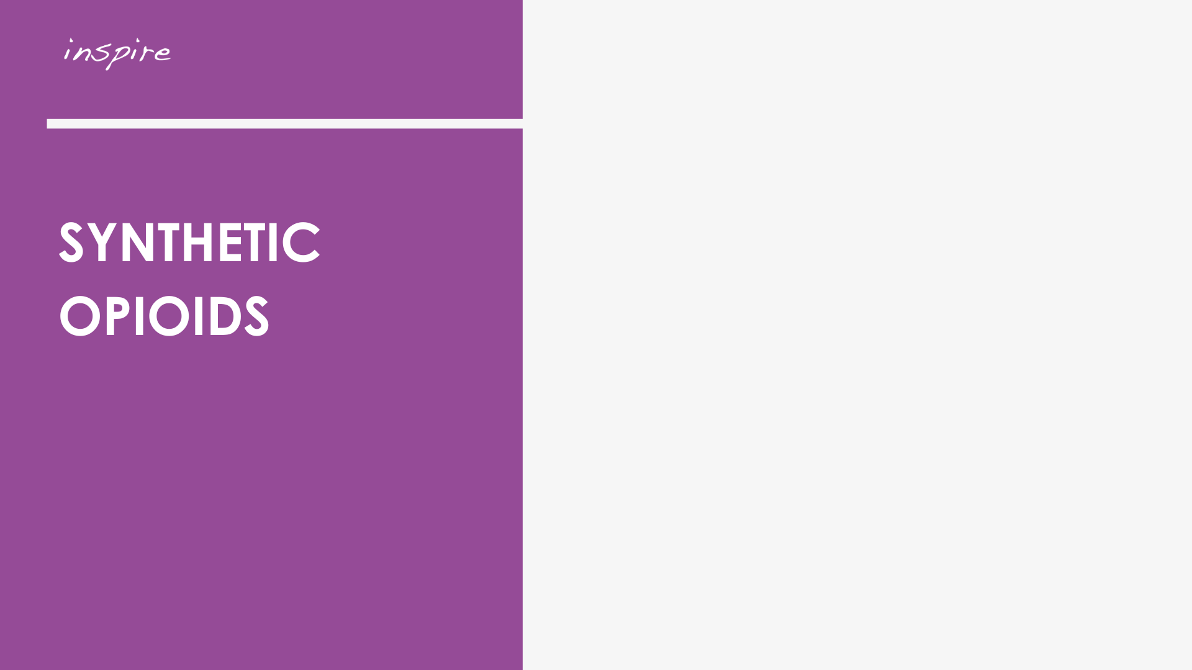
What are they?
Illegally produced in laboratories overseas
Potent synthetic opioids like fentanyl and nitazenes are most often found added to heroin, making those who use them more vulnerable to overdose.
They have also been found mixed with synthetic cannabinoids like herbal cannabis or Spice.
Act on the same parts of the brain as traditional opiates
Examples - Fentanyl, Carfentanyl, Nitazines Tramodal, Oxycodone
More potent than traditional opiates (purity of heroin has decreased over time)
May require more Naloxone to reverse effects of overdose

Slide 46
Why are Synthetic Opioids appearing in the UK?
Afghanistan supplies 80% of the world’s opiate demand & 95% of the European heroin market
In April 2022, the Taliban’s supreme leader banned cultivation of Opium poppies
Opium prices soared following this announcement – one farmer estimated that he could sell a bag of opium for 5x the price this year than last
It is estimated that less than 20% of what was grown last year is being grown in 2023

Slide 47
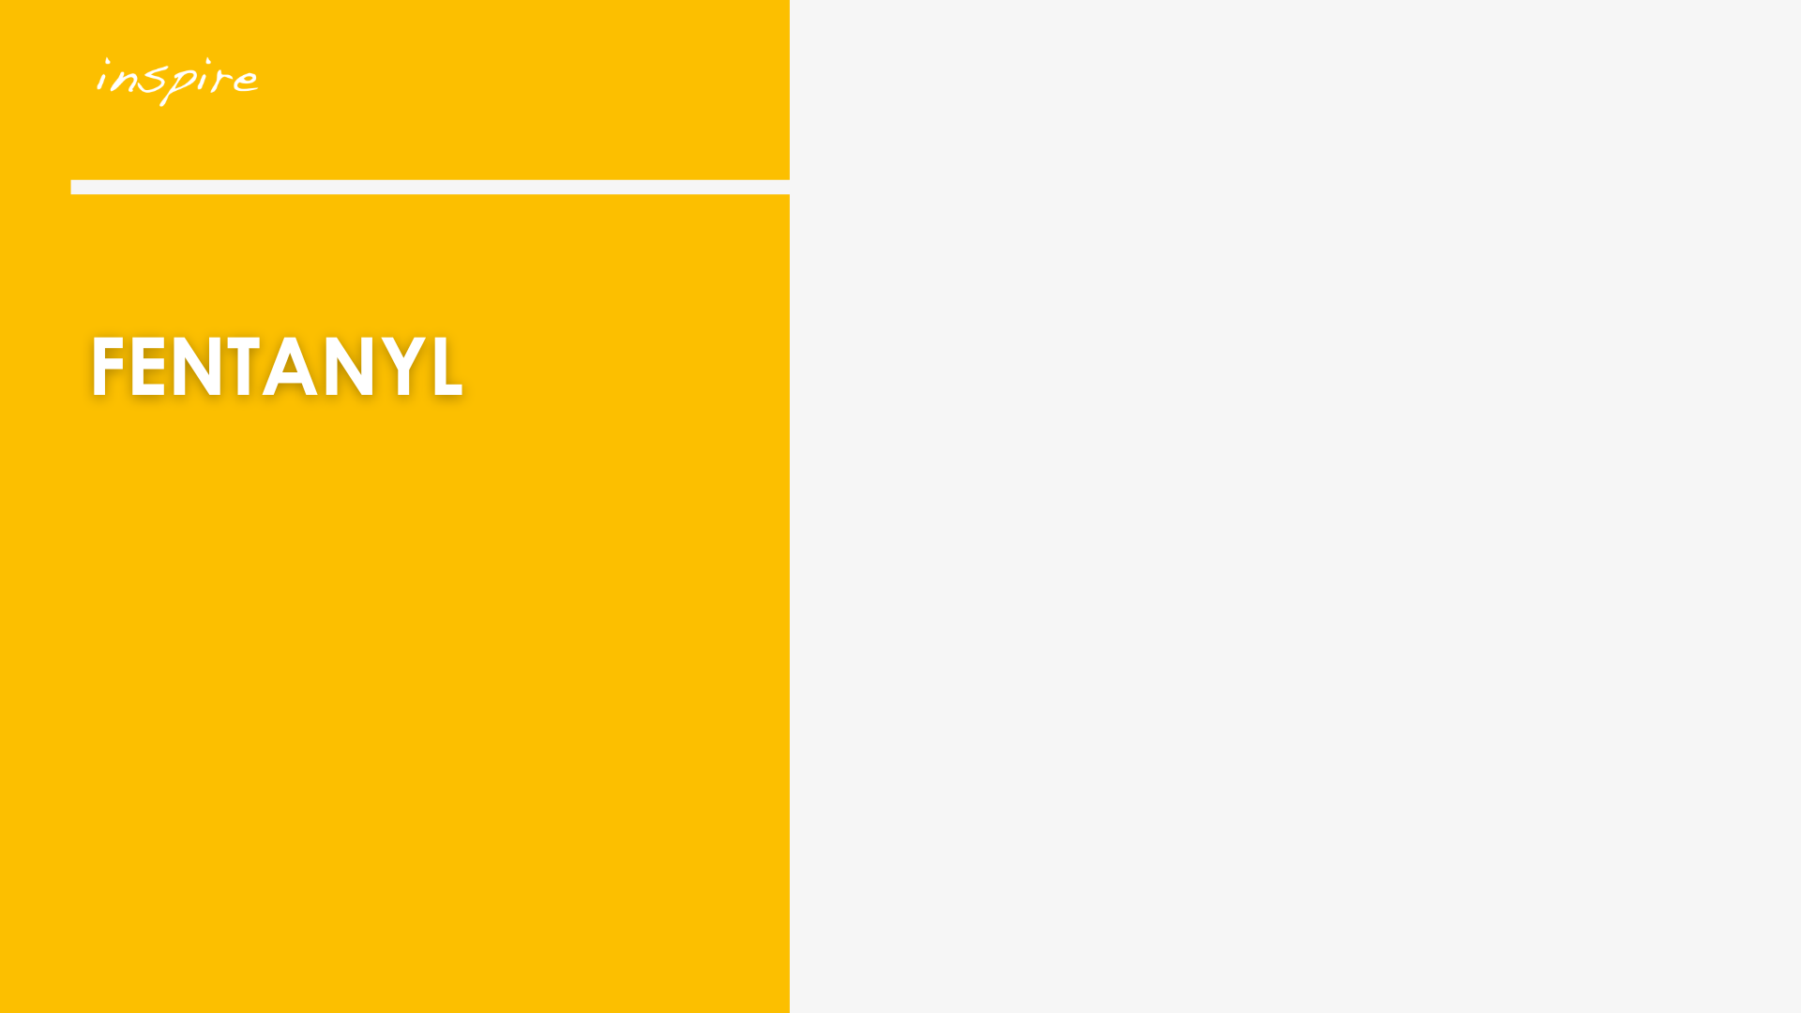
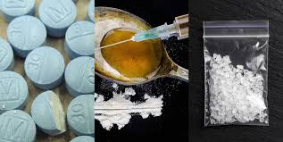
Fentanyl & Overdose
Fentanyl and other synthetic opioids are common drugs involved in overdose deaths. Even in small doses, it can be deadly.
Heroin may contain deadly levels and you wouldn’t be able to see it, taste it, or smell it.
Powdered fentanyl looks just like many other substances.

Slide 48
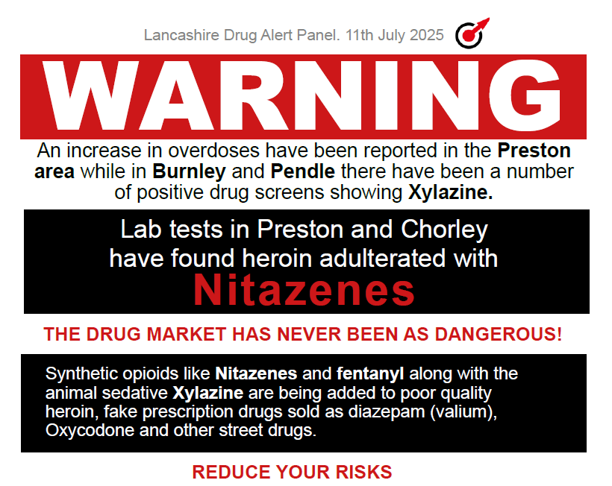

Slide 49
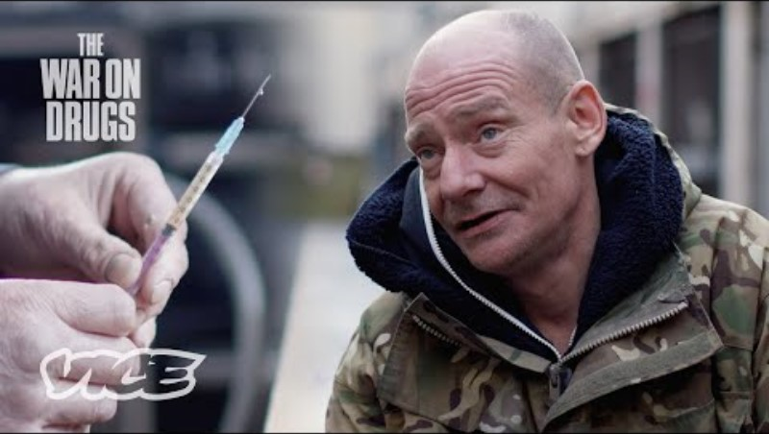

Slide 50

Policies and practices that try to reduce the harm that people do to themselves or others from their drug use.
DrugWise
What is Harm Reduction?

Slide 51
The Basics
Know your limits – consider any health issues that may increase your risk of overdose
Stay hydrated! Drink plenty of water or other fluids.
Alternate nostrils if snorting
Use in a clean, safe space to minimise risk of infection
Use the local Needle Exchange for clean equipment
Test your substances using test strips from Inspire

Slide 52
Avoid mixing alcohol with heroin and non prescribed medications
Use heroin prior to drinking or using benzos to better gauge its effects
Use one drug at a time if a polydrug user
Harm Reduction for Heroin

Slide 53
Don’t use alone
Go low and slow
Smoke instead of injecting
Alternate injecting sites
Remove tourniquet after finding vein but before injecting
Carry naloxone and have some in property
Harm Reduction for Heroin

Slide 54
Develop an overdose plan with friends, partner or family.
Leave the door unlocked where possible.
Call or text someone you trust and have them check on you at agreed times.
Using Alone
Harm Reduction for lone users

Slide 55
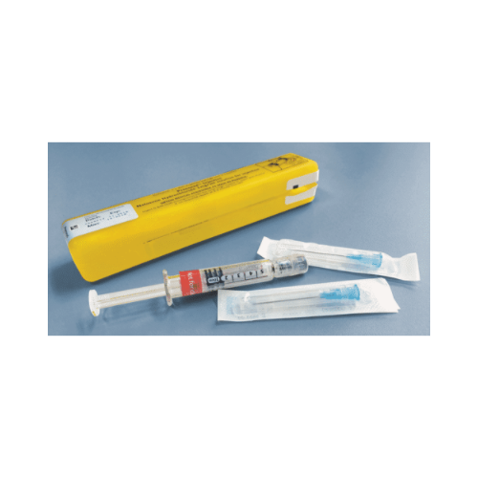

Slide 56
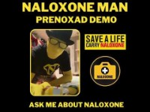

Slide 57
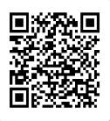
Thank you for participating

