Slide 1

Modern Slavery:
An Overview
Lizzie Muir | Community Engagement Officer
Contact | e.muir@antislavery.org | +44 (0)20 8142 7723
antislavery.org
2020 © Anti-Slavery International

Slide 2
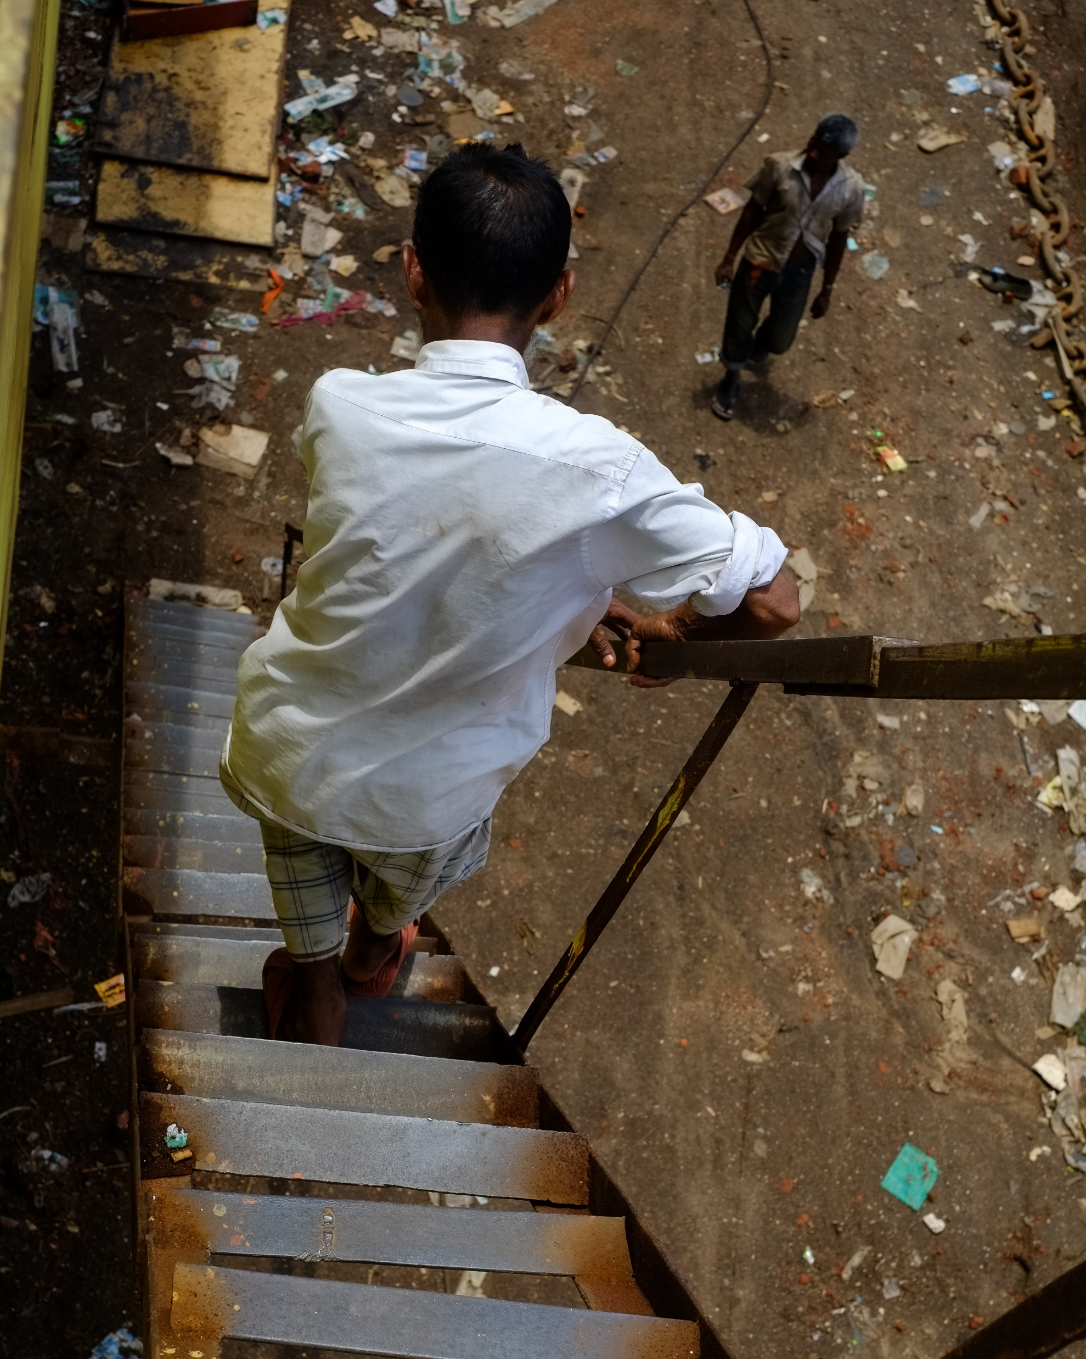
Who are Anti-Slavery International?
Founded in 1839, we are the oldest human rights organisation in the world
We tackle the root causes of modern slavery: poverty, discrimination and weak systems of law
We work towards sustainable, long-term changes with global partners
Image by: Jonathan Moore, www.jonathanmoorephotography.com, Instagram @jdcmoore
antislavery.org
Notes:
2

Slide 3
What is modern slavery?
At Anti-Slavery International, we define modern slavery as when an individual is exploited by others, for personal or commercial gain. Whether tricked, coerced, or forced, they lose their freedom.
Image by: Jonathan Moore, www.jonathanmoorephotography.com, Instagram @jdcmoore
antislavery.org
Notes:
3

Slide 4
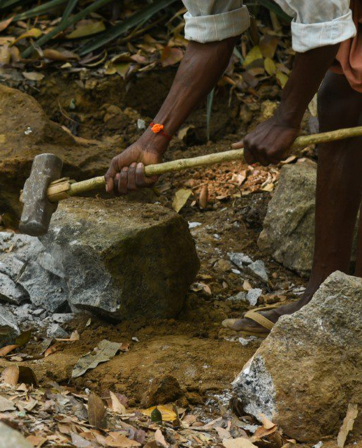
Forms of modern slavery
Image by: Santhosh Varghese via Shutterstock
Domestic servitude
Forced and child marriage
Forced labour
Child slavery
Human trafficking
Bonded/debt labour
Descent based slavery
antislavery.org
Notes:
4

Slide 5
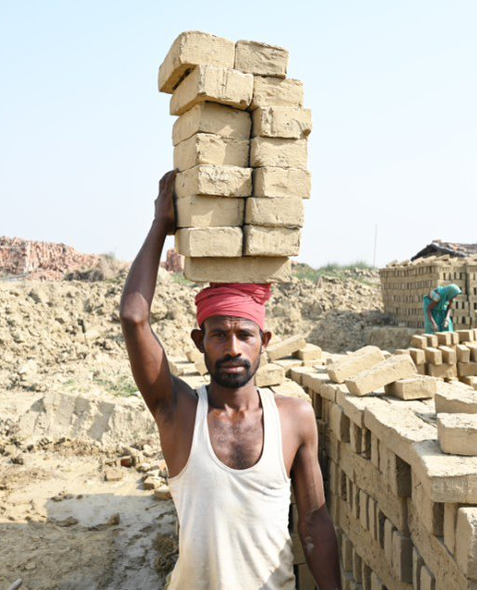
Slavery today
Image by: Bank India via Shutterstock
Nearly 50 million people living in modern slavery – 1 in every 150 people
  27.6 million people are in forced labour (11.8 million are women/girls, 3.3 million are children)
  22 million people are in forced marriage
  6.3 million people are in forced commercial sexual exploitation
  3.9 million people are in state-imposed forced labour
antislavery.org
Notes:
5

Slide 6
Anti-Slavery International’s key 4 strategic areas
Image by: Bank India via Shutterstock
Child slavery
Migration and trafficking
Climate change
Responsible business and human rights
antislavery.org
Notes:
6

Slide 7
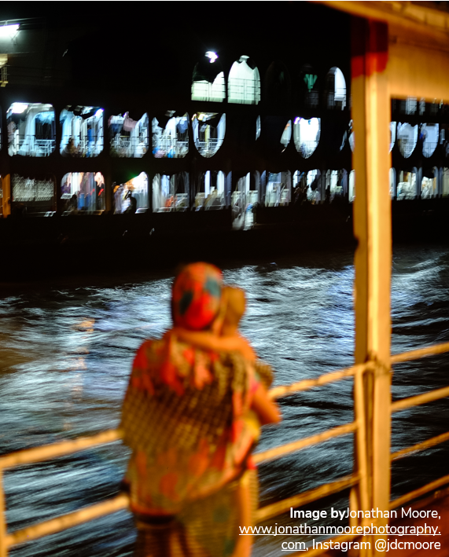
Migration and Trafficking
Migrant workers are 3 times more likely to end up in forced labour exploitation in the private sector, than local workers
45% of all identified victims of trafficking in 2022 had been trafficked across international borders
antislavery.org

Slide 8
Our work to help safe migration and end trafficking
We host and chair the Anti-Trafficking Monitoring Group
Research and advocacy around trafficking in the UK
Supporting migrant workers in Mauritius
Currently leading an in-depth investigation into trafficking routes
antislavery.org

Slide 9
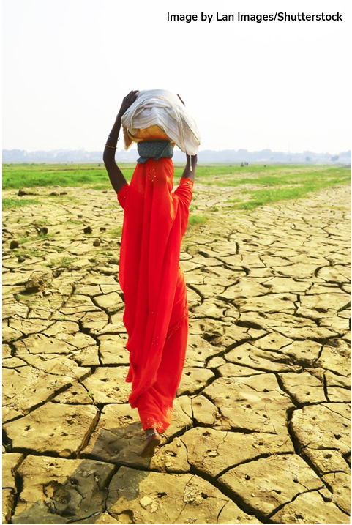
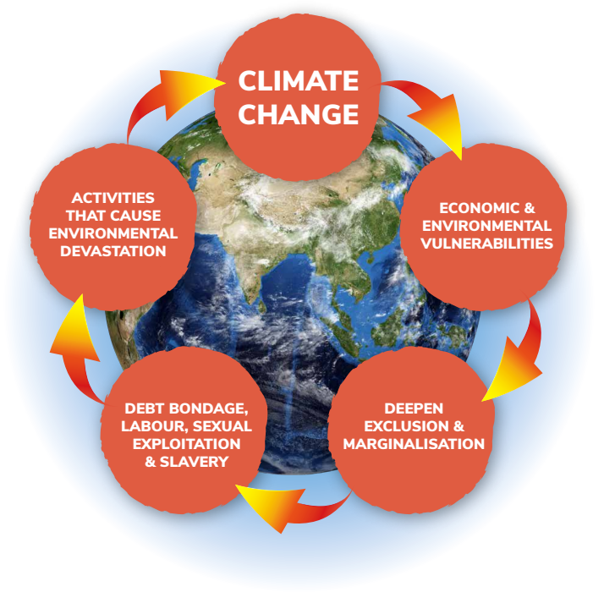
Climate change
antislavery.org

Slide 10
Our work on climate change
Legal protection
Just Transition
Leave no-one behind
antislavery.org

Slide 11

Spotting the signs
Photo/diagrams/ infographics/graphs etc area.
Image by: Progressman via Shutterstock
Appear to be under the control of someone else and reluctant to interact with others
Not have personal identification on them
Have few personal belongings, wear the same clothes or wear unsuitable clothes for work
Not be able to move around freely
Be reluctant to talk to strangers or the authorities
Appear frightened, withdrawn, or show signs of physical or psychological abuse
Dropped off and collected for work always in the same way, especially at unusual times, i.e. very early or late at night.
Modern Slavery Helpline: 0800 0121 700
antislavery.org

Slide 12
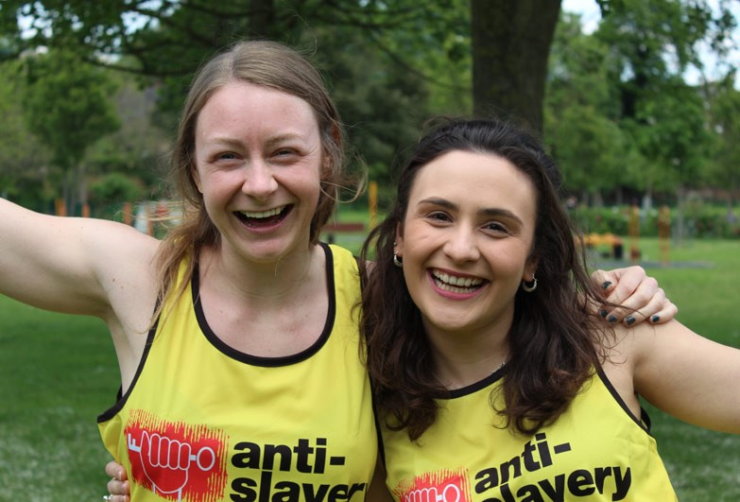
Six things you can do
Learn: know where modern slavery can exist and how it manifests by subscribing to our emails and following us on social media
Spot the signs. Report suspicious behaviour
Support the movement financially. A donation of just £10 will make a vital difference by supporting the partners and projects we help
Share information with friends, family members, colleagues. Ending modern slavery is a huge task and we need everyone involved
Use your consumer power. Ask businesses you buy from how they are making sure their products are not made with modern slavery
Fundraise for us. Raise money and engage with your employer
Image by:
Anti-Slavery
International
antislavery.org

Slide 13
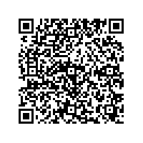

If you would like to donate, you can scan this QR code, or go to https://donorbox.org/speaker
Thank you!
Anti-Slavery International
+44 (0)20 7501 8920
info@antislavery.org
UK Head Office
The Department Store Studios
19 Bellefields Road
London
SW9 9UH
Lizzie Muir | Community Engagement Officer
Contact | e.muir@antislavery.org | +44 (0)20 8142 7723
antislavery.org
2020 © Anti-Slavery International

