Slide 1
Basic Office
Fire Safety Induction 2022
Tactical Security Options Ltd,
Room 704 Cameron House White Cross Industrial Estate
South Road Lancaster LA1 4XF
Tel: 07787788811
dgap@Hotmail.co.uk
Dave Pattinson 2.1 V5

Slide 2
Fire Safety Advisor for today is:
Dave Pattinson & Stacey Vivian
dgap@Hotmail.co.uk
Tel: 077877888111
Please……….
  Make sure you have signed the register
  Turn off mobile phones, pagers etc.

Slide 3
Why is it important?
Legal obligation Health & Safety Act 1974
Public expectation
Professional standards PSIA & SIA Guidance
The needs of our clients will drive everything we do
Notes:
Legal obligation under the Regulatory Reform (Fire Safety) Order 2005 to manage fire safety and provide safe environment for employees and non employees. Also H&SW Act 1974 to provide a safe work place.
Public Expectation – The public, patients, visitors etc. will expect to be safe in a hospital environment.
Professional standards – Individual pride in work, competence etc.
The needs of our patients underpins all our activities – safety must be paramount and we need to be able to demonstrate organisational competency in action to be taken in the event of fire.

Slide 4
This Session
Introduction
Aim and Outcomes
General Fire Precautions
Action in the event of fire
New Developments
Open Forum
Notes:
Identifies framework of session; key issue is to encourage open discussion, questions and challenge.

Slide 5
Aim
To ensure all staff are aware of the action to be taken in case of fire.
Notes:
Clear aim that the session is all about ensuring staff are aware of actions to be taken and that the Trust can demonstrate training has been given.

Slide 6
Outcomes
Understand the components of a fire
Appreciate the main causes of a fire
Understand the basic legal requirements and evacuation procedure
To become competent with the management of fire safety
Identify types of extinguishers and their use.
Notes:
Understand the components of fire – Basic triangle of combustion and how fire is extinguished.
Appreciate the main causes of fire – Outline of main causes of fire in NHS premises.
Understand the basic legal requirements and evacuation procedure – Staff need to be aware of individual responsibilities and how these are applied in the workplace.
To become competent with the management of fire safety – Although aimed primarily at managers; everyone has a part to play in ensuring a safe environment for our patients, visitors and work colleagues.
Identify types of extinguishers and their use – Two types of extinguisher and basic instruction on usage. Brief mention of fire blanket and the effectiveness of this simple method of firefighting.

Slide 7
The Anatomy of Fire
FIRE
OXYGEN
HEAT
FUEL
Notes:
Opening discussion about the triangle of combustion. Describe what is required for fire to occur and how any one of the sides will result in extinction.

Slide 8
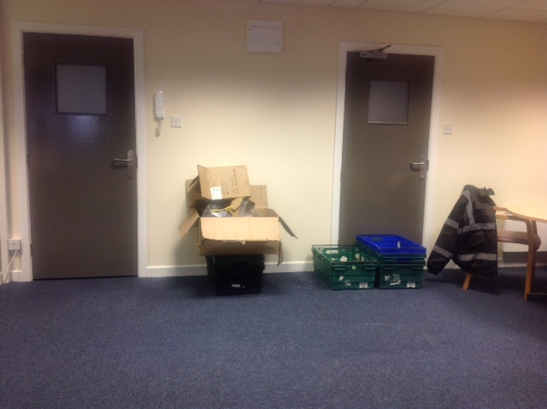
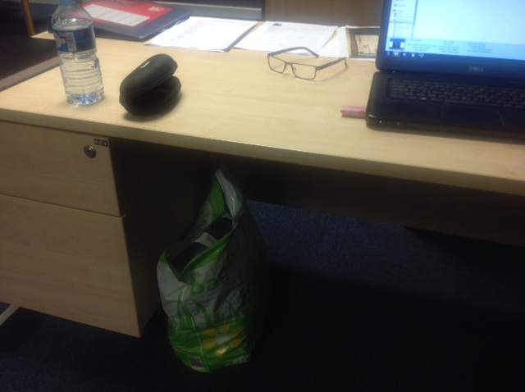
From this ………..
Notes:
Shock style introduction – Apologise if the untidy office embarrasses anybody, but this is the situation that leads to rapid fire spread due to poor housekeeping and combustible fire loading. Describe how triangle of combustion forms.

Slide 9
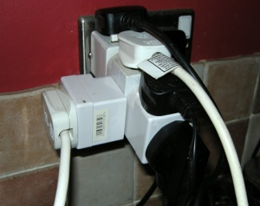
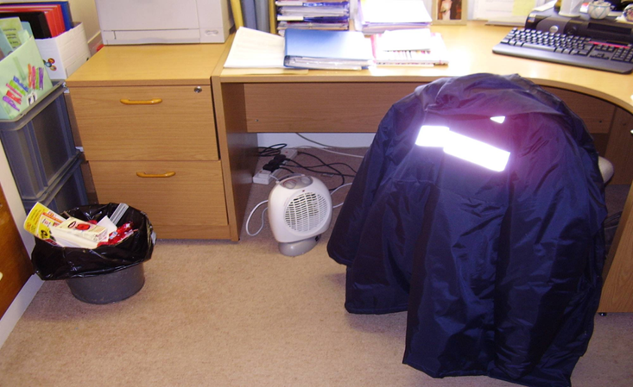
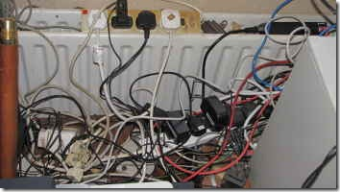
or this ………..
Notes:
Slide showing hazards of portable heater supplied by multi-point adaptor. Looks like fire is being used to dry clothing

Slide 10
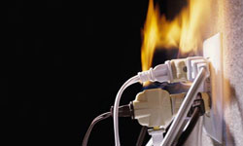
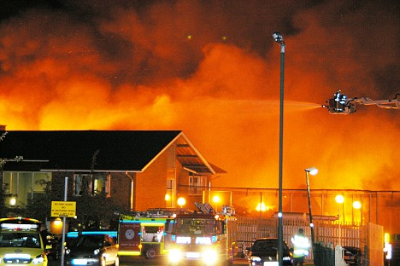
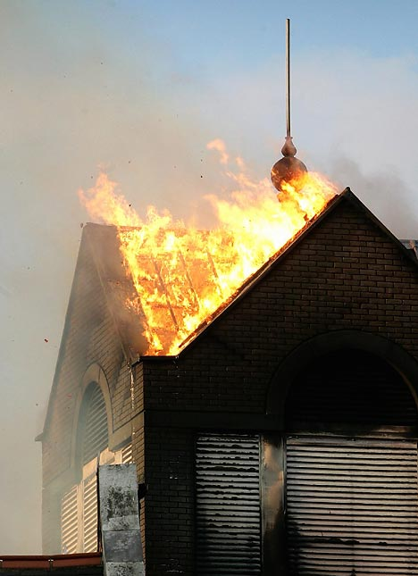
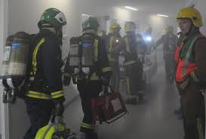
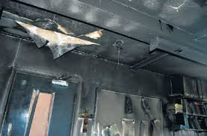
To this ………..
Notes:
Severe fire situation.

Slide 11
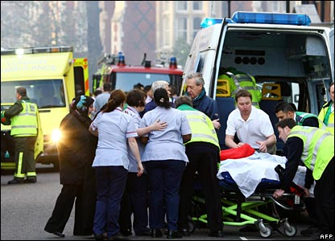
and this ………..
Notes:
Evacuation of patients.

Slide 12
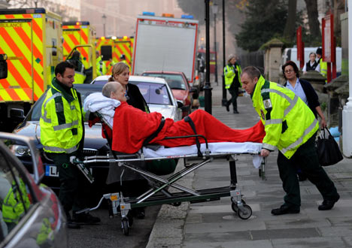
and this ………..
Notes:
Evacuation of patients.

Slide 13
Causes of Fire in Office Premises
Cooking equipment
Careless smoking by visitors and staff
Equipment failure, electrical
Arson
Poor House keeping.
Notes:
Generalised list of causes.

Slide 14
Common Denominator
PEOPLE
Most fires at work are caused by:-
Poor judgement
Human error
Failure to follow instructions.
Notes:
The people factor is a root caused of all fires.

Slide 15
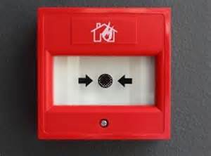
Fire Alarm Activation
Manual - Breaking the glass of any fire alarm point MCP (Dial 999)
Automatic - Smoke or Heat Detectors
Activation of the fire alarm system will
set off the fire alarm indicator panels.
if there is a fire the server may go down taking the telephone lines out, staff MUST call (999) every time.
Notes:
Types of fire alarm activation.

Slide 16

Fire Alarm Activation
Notes:
Types of fire alarm activation.

Slide 17
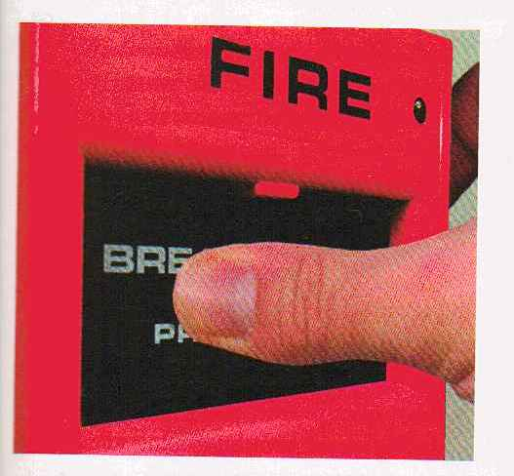
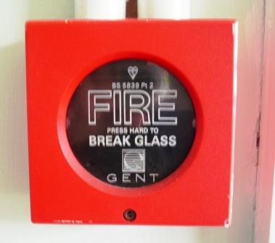
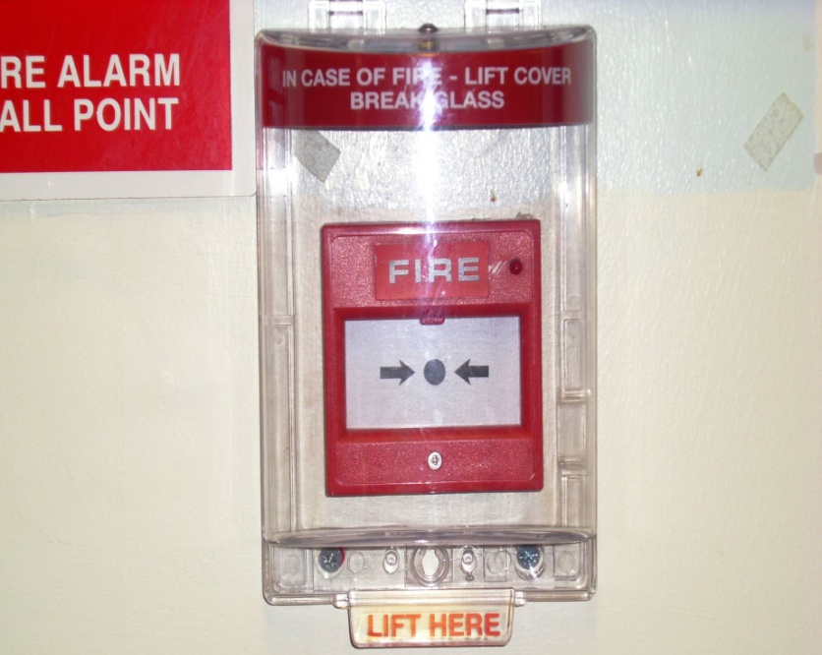
Manual Fire Alarm MCPs
Standard type
All Red in Colour
Protected
Notes:
Different call points.

Slide 18
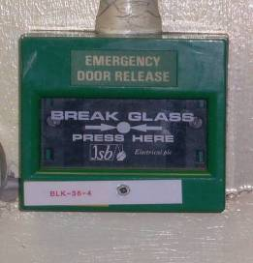
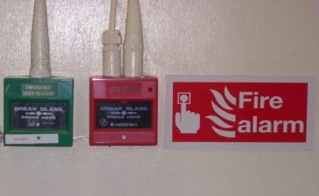
Do Not Confuse ……
Emergency Door
Release
Sometimes sited together
Notes:
Can be confused with emergency door releases. Care should be taken to know which is which.

Slide 19
Fire Evacuation Plan
A continuous alarm sound will indicate that there is a fire in your part of the office block.
(Weekly test) will be carried out on a Friday.
(Fire Drills) we will carry out every six months or wherever there is a change.
Notes:
Continuous alarm – Evacuate immediately (non patient area). Investigate/await instruction in patient area.
Intermittent Alarm – On hearing an intermittent alarm sound staff should remain at their place of duty from where they may be summoned if required.
BE PREPARED – to evacuate should the alarm change to a continuous sound.

Slide 20


Fire Action
  Close doors & Windows
  Await instruction
Intermittent
Intermittent
Intermittent
Continuous Alarm
  Non patient area
  Leave building by nearest exit
  Report to Assembly Point
Intermittent
Intermittent
  Patient area:
  Staff await Instructions
  Manager Investigate
Notes:
Pictorial description of how the fire alarm system works and action to be taken at each stage.

Slide 21
Evacuation, Assembly and Role Call
The senior person shall be responsible for:-
Co-ordination of the evacuation
Carrying out a sweep and search of all rooms where possible and safe to do so
Positioning fire wardens to prevent entry to area
Ensuring a role call is taken.

Slide 22
Evacuation, Assembly and Role Call

Slide 23
Evacuation, Assembly and Role Call
Evacuate ground floor office and building
Exit main blue door in to car park or fire exit to the left of the office
Roll call at assembly point by car park
Call 999 await fire service for brief

Slide 24

Progressive Horizontal Evacuation
_{Fire}
_{Stairs}
_{Fire}
_{Stairs}
Bay 1
Bay 2
Bay 3
Bay 2
Nurses
Station
Ward 3
Doctor
Bay 6
Clinic
Pantry
Bay 5
Ward 2
Courtyard
Courtyard
Courtyard
Ward 4
_{ASSEMBLY}
_{POINT}
Notes:
The terminology associated with Hospital Horizontal Evacuation and Refuges (Assembly Points) covers:
Evacuation - the rapid and orderly removal of patients, visitors and staff in priority order from danger as instructed by the Fire Team Leader BRONZE.
Horizontal - remaining on the same level of the building until advised that patients etc will have to be moved to a lower level or to another building. Patients are to remain in the building until clear instructions are given for their removal elsewhere as many patients would be adversely affected by the weather even in summer.
Assembly point - any space or room large enough to cope with an influx of about 30 patients and their medical equipment vital for survival designated as a refuge. Assembly points must be near to lifts or stairs that are suitable for vertical evacuation should it become necessary. Rooms are used for other functions until evacuation is ordered.
Refuge - NHS term for assembly point

Slide 25
Securing of Building
Upon receiving orders to re-enter the office block by a Senior Fire Officer, carry out the following:
Check and secure all fire doors
Check and ensure fire equipment is operational and reported if used
Log the event on an incident report
Notes:
The terminology associated with Hospital Horizontal Evacuation and Refuges (Assembly Points) covers:
Evacuation - the rapid and orderly removal of patients, visitors and staff in priority order from danger as instructed by the Fire Team Leader BRONZE.
Horizontal - remaining on the same level of the building until advised that patients etc will have to be moved to a lower level or to another building. Patients are to remain in the building until clear instructions are given for their removal elsewhere as many patients would be adversely affected by the weather even in summer.
Assembly point - any space or room large enough to cope with an influx of about 30 patients and their medical equipment vital for survival designated as a refuge. Assembly points must be near to lifts or stairs that are suitable for vertical evacuation should it become necessary. Rooms are used for other functions until evacuation is ordered.
Refuge - NHS term for assembly point

Slide 26
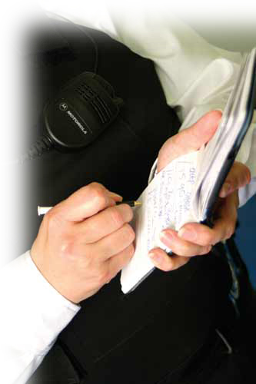
Reporting & Accountability
Log the event on an incident report
Report findings to a Senior Manager
Inform work colleagues
Notes:
The terminology associated with Hospital Horizontal Evacuation and Refuges (Assembly Points) covers:
Evacuation - the rapid and orderly removal of patients, visitors and staff in priority order from danger as instructed by the Fire Team Leader BRONZE.
Horizontal - remaining on the same level of the building until advised that patients etc will have to be moved to a lower level or to another building. Patients are to remain in the building until clear instructions are given for their removal elsewhere as many patients would be adversely affected by the weather even in summer.
Assembly point - any space or room large enough to cope with an influx of about 30 patients and their medical equipment vital for survival designated as a refuge. Assembly points must be near to lifts or stairs that are suitable for vertical evacuation should it become necessary. Rooms are used for other functions until evacuation is ordered.
Refuge - NHS term for assembly point

Slide 27
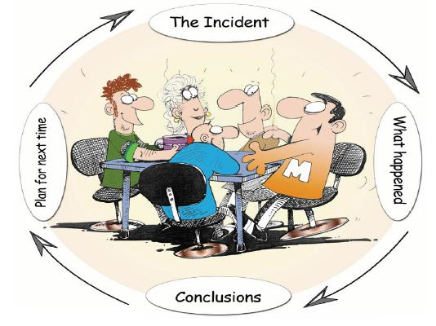
Meeting
Have a meeting de-briefing regarding the fire evacuation
Learn from it or adjust the RAMs accordingly
Notes:
The terminology associated with Hospital Horizontal Evacuation and Refuges (Assembly Points) covers:
Evacuation - the rapid and orderly removal of patients, visitors and staff in priority order from danger as instructed by the Fire Team Leader BRONZE.
Horizontal - remaining on the same level of the building until advised that patients etc will have to be moved to a lower level or to another building. Patients are to remain in the building until clear instructions are given for their removal elsewhere as many patients would be adversely affected by the weather even in summer.
Assembly point - any space or room large enough to cope with an influx of about 30 patients and their medical equipment vital for survival designated as a refuge. Assembly points must be near to lifts or stairs that are suitable for vertical evacuation should it become necessary. Rooms are used for other functions until evacuation is ordered.
Refuge - NHS term for assembly point

Slide 28
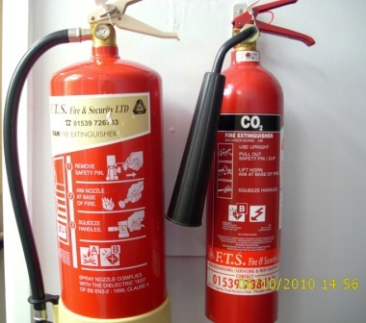
Extinguishers
Foam
CO₂
Fire extinguishers are placed at strategic locations, painted red in line with EC legislation
Notes:
Two types of extinguisher in use across the Trust.
Foam – Description; red with cream panel. For use on Class A or B fires (general use). Operates by cooling and smothering.
CO2 – Description red with black panel, tapered discharge horn. For use on electrical risk. Minimal damage when used, noisy, operates by excluding oxygen. Risk of re-ignition.
Should be wall mounted – not to be used as door prop.

Slide 29
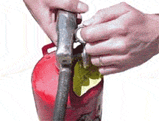
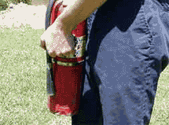
Extinguisher Operation
P.A.S.S Method
P – Pull Safety Seal and Pin
A – Aim at base of fire
Notes:
Describe PASS method.

Slide 30
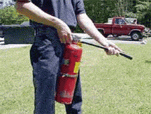
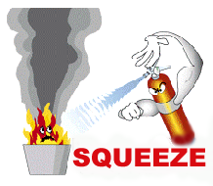
Extinguisher Safety
P.A.S.S Method
S – Squeeze the lever
S - Sweep from side to side

Slide 31

Fire Fighting Action
Sound the fire alarm
Do not use the extinguishers unless
  The fire is small and you are confident
  Trained and It is safe to do so
  Otherwise leave the building by the designated exits closing all windows and doors as you leave.
Notes:
Always sound the fire alarm
Be aware fire extinguishers only last 10 – 15 seconds CO2, 75 seconds water/foam, make sure your first shot is on target (efficient use).
Make sure you don’t blow burning papers out of wastebasket fires, stand back about 2 metres.
Don’t attempt to fight a fire that is too big, can’t be put out easily or involves burning gas.

Slide 32
Dangers of Fighting
Approaching the fire itself
Smoke
Being trapped by the fire
Bigger than you expected!
Gases
  Cylinders
  Aerosols
  Piped systems
Notes:
Describe hazards when firefighting. This is a last resort as attention to patients should be the priority.

Slide 33
Summary
Operate alarm
Staff to call the fire service (999)
Evacuation
Assemble at RVP
Roll call (Fire Register)
Firefighting Equipment
Attack a fire only if safe to do so!
Notes:
Fire may be discovered by seeing it, smelling it or hearing it. The alarm must be raised at once and the fire brigade called.
As soon as the alarm is raised, leave the building by the quickest, safest route. Don’t wait to collect any belongings but if you have any specific tasks e.g. turning or switching off heat generating equipment in your area, do them quickly and leave the building as soon as you can.
Help people who don’t know their way around such as visitors and those who are disabled, have impaired vision or hearing.
Close doors behind you. This will help stop the spread of fire, smoke and heat.
Don’t use lifts unless they are special evacuation lifts designated by a fire officer in accordance with special procedures for the disabled.
Go to the fire assembly point. Make sure all your colleagues are accounted for (a fire warden may conduct a roll call) and tell the person in charge if anyone is missing.
Do not return to the building unless told by the person in charge it is safe to do so.
REMEMBER, ONLY ATTACK THE FIRE IF IT IS SAFE TO DO SO!

Slide 34
Other Issues
Call Challenge Procedure
Vertical Evacuation
Safe Refuge Areas
General Fire Safety Training - Drills

Slide 35
Thank You
Any Questions?

